Slide 1
Understanding the role of nitrogen availability and acquisition strategy on plant responses to global change
Evan A. Perkowski

Slide 2
Adapted from Fig 5.12 in IPCC (2021)
Notes:
x-axis = Major carbon flux components between the atmosphere and biosphere

Slide 3
Photosynthesis = largest carbon flux between the atmosphere and land surface
Adapted from Fig 5.12 in IPCC (2021)
Notes:
The "Land in” component is driven by photosynthesis, suggesting that photosynthesis is the largest carbon flux between the atmosphere and biosphere

Slide 4
Photosynthesis = largest carbon flux between the atmosphere and land surface
Terrestrial biosphere models must accurately predict photosynthetic fluxes to reliably predict ecosystem responses to environmental change
Adapted from Fig 5.12 in IPCC (2021)
Notes:
As a result…

Slide 5
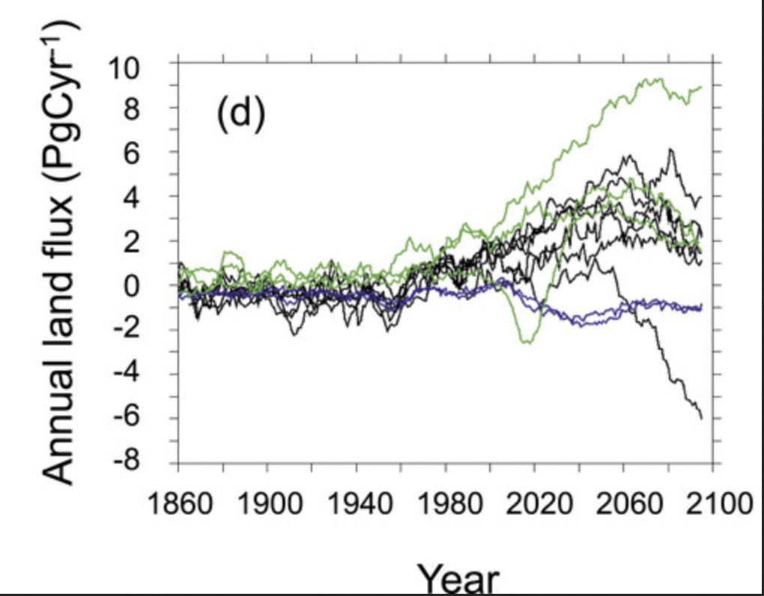
Terrestrial biosphere model carbon flux simulations converge under past environmental conditions
Carbon sink
(Flux in > flux out)
Carbon source
(Flux in < flux out)
Friedlingstein et al. (2014) Journal of Climate
Notes:
x-axis = year
y-axis = land carbon flux
Fluxes
Agreement between model simulations are likely because these models were parameterized using historical climate data

Slide 6
However, model simulations exhibit strong divergence under future environments
Carbon sink
(Flux in > flux out)
Carbon source
(Flux in < flux out)
Friedlingstein et al. (2014) Journal of Climate
Notes:
Many possible explanations to explain this phenomenon
One thought is that this divergence is driven by the lack of the nitrogen cycle in terrestrial biosphere models,
but this could also be driven by uncertainty in the response of photosynthetic acclimation responses to novel environments

Slide 7
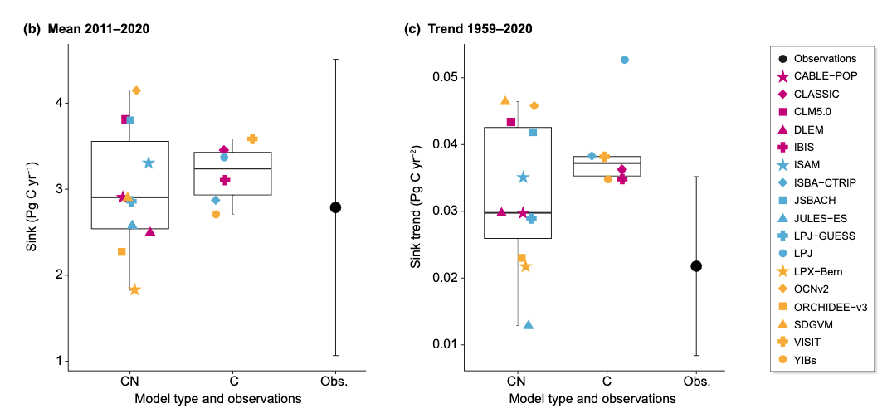
This divergence may be due to a poor understanding of the mechanisms that drive processes that regulate C and N cycles
Stocker et al. (2024) New Phytologist

Slide 8
This divergence may be due to a poor understanding of the mechanisms that drive processes that regulate C and N cycles
Stocker et al. (2024) New Phytologist
Notes:
While CN models more accurately quantify carbon sink trends compared to models that only include the C cycle, the variability in simulated C sink trends across CN-models suggests that we need to better understand mechanisms that drive the processes that link C-N cycles to consistently model these processes

Slide 9


N uptake and photosynthesis are two processes in terrestrial ecosystems where C and N are coupled
CO₂
Photosynthesis
Schematic adapted from Brzostek et al. (2014) Biogeosciences

Slide 10
N uptake and photosynthesis are two processes in terrestrial ecosystems where C and N are coupled
CO₂
Photosynthesis
C_{transfer}
C_{growth}
Schematic adapted from Brzostek et al. (2014) Biogeosciences

Slide 11
N uptake and photosynthesis are two processes in terrestrial ecosystems where C and N are coupled
CO₂
Photosynthesis
C_{transfer}
C_{growth}
N_{uptake}
N_{available}
Schematic adapted from Brzostek et al. (2014) Biogeosciences
Notes:
Regardless of acquisition strategy,
plants must allocate carbon belowground to acquire nitrogen,
implying an inherent carbon cost associated with acquiring nitrogen

Slide 12
N uptake and photosynthesis are two processes in terrestrial ecosystems where C and N are coupled
CO₂
Photosynthesis
C_{transfer}
C_{growth}
N_{leaf}
N_{uptake}
N_{available}
Schematic adapted from Brzostek et al. (2014) Biogeosciences
Notes:
Regardless of acquisition strategy,
plants must allocate carbon belowground to acquire nitrogen,
implying an inherent carbon cost associated with acquiring nitrogen

Slide 13
N uptake and photosynthesis are two processes in terrestrial ecosystems where C and N are coupled
CO₂
Photosynthesis
How is the relationship between belowground C allocation and plant N uptake influenced by global change?
C_{transfer}
C_{growth}
N_{leaf}
N_{uptake}
N_{available}
Schematic adapted from Brzostek et al. (2014) Biogeosciences
Notes:
Regardless of acquisition strategy,
plants must allocate carbon belowground to acquire nitrogen,
implying an inherent carbon cost associated with acquiring nitrogen

Slide 14

N uptake and photosynthesis are two processes in terrestrial ecosystems where C and N are coupled
CO₂
Photosynthesis
How is the relationship between belowground C allocation and plant N uptake influenced by global change?
C_{transfer}
C_{growth}
What is the role of N availability on plant photosynthetic responses to global change?
N_{leaf}
N_{uptake}
N_{available}
Schematic adapted from Brzostek et al. (2014) Biogeosciences
Notes:
Regardless of acquisition strategy,
plants must allocate carbon belowground to acquire nitrogen,
implying an inherent carbon cost associated with acquiring nitrogen

Slide 15
How is the relationship between belowground C allocation and plant N uptake influenced by global change?

Slide 16
Plants must allocate carbon belowground to acquire nutrients, implying that there is an inherent carbon cost of acquiring nitrogen
CO₂
Photosynthesis
C_{transfer}
C_{growth}
N_{leaf}
N_{uptake}
N_{available}
Schematic adapted from Brzostek et al. (2014) Biogeosciences
Notes:
Regardless of acquisition strategy,
plants must allocate carbon belowground to acquire nitrogen,
implying an inherent carbon cost associated with acquiring nitrogen

Slide 17
Increasing soil nitrogen availability may decrease costs to acquire nitrogen due to increased per-root nitrogen uptake
CO₂
Photosynthesis
C_{transfer}
C_{growth}
N_{leaf}
N_{uptake}
N_{available}
Schematic adapted from Brzostek et al. (2014) Biogeosciences
Notes:
Importantly, carbon costs to acquire nitrogen are dynamic and likely change with changing aboveground or belowground environmental conditions.

Slide 18
Increasing soil nitrogen availability may decrease costs to acquire nitrogen due to increased per-root nitrogen uptake
Carbon cost to
acquire nitrogen
N availability
Schematic adapted from Brzostek et al. (2014) Biogeosciences

Slide 19
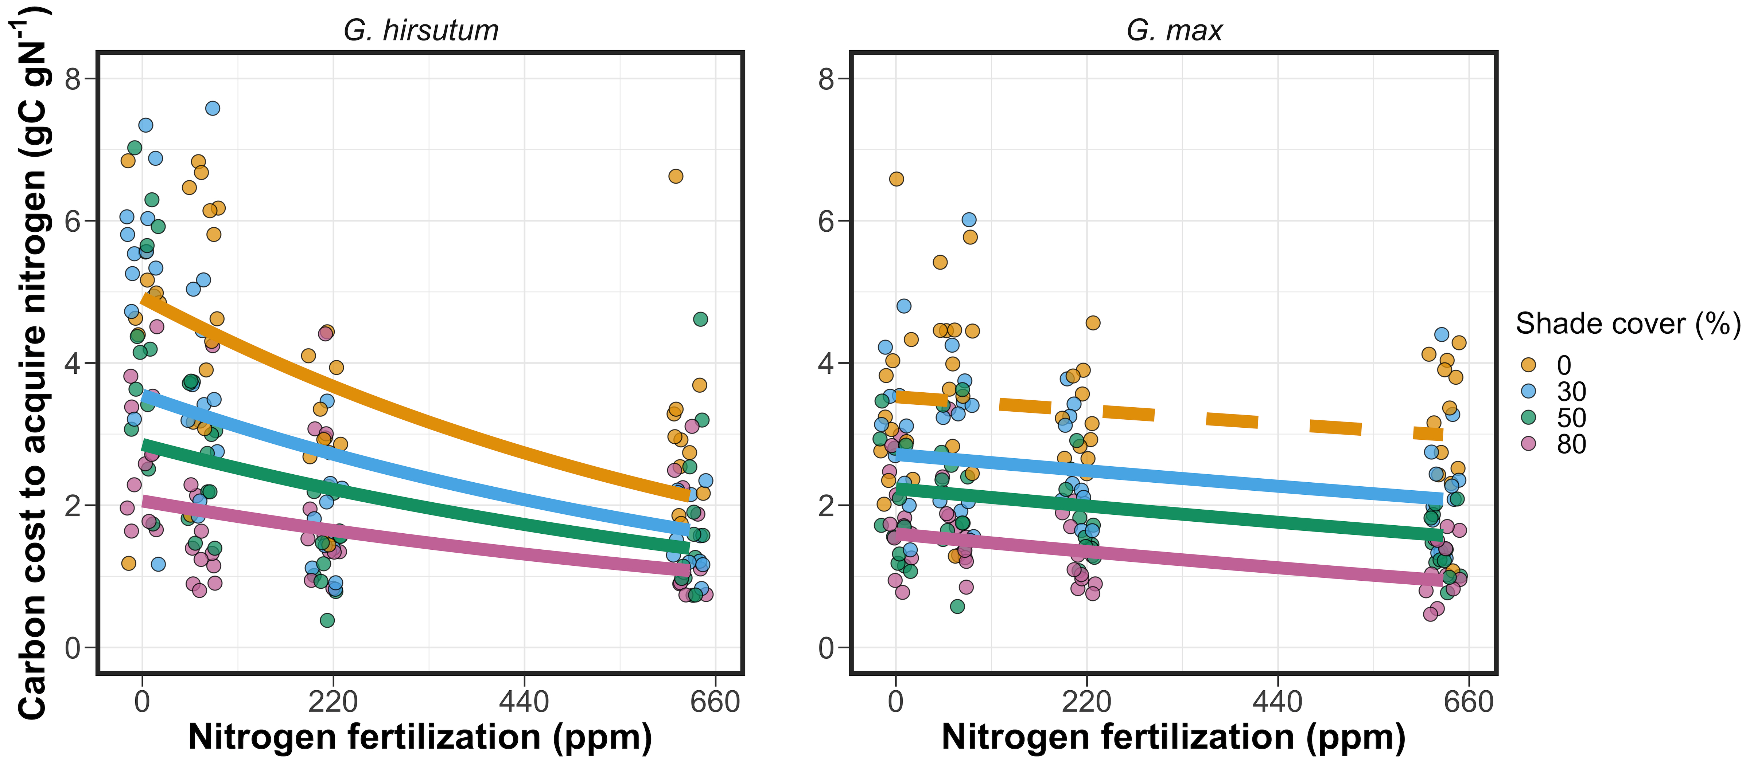


Carbon costs to acquire nitrogen decrease with increasing fertilization
Perkowski et al. (2021) Journal of Experimental Botany

Slide 20
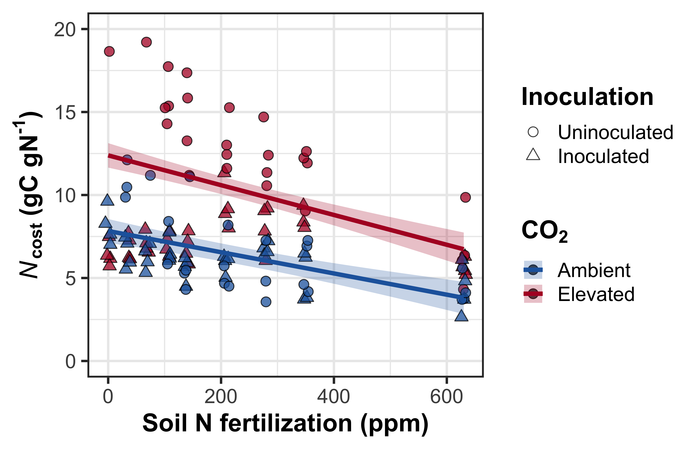
Carbon costs to acquire nitrogen decrease with increasing fertilization
Perkowski et al. (in review)

Slide 21
Increasing nitrogen availability decreases carbon costs to acquire nitrogen in the field, too!
Carbon cost of
nitrogen acquisition
relative to water
Perkowski et al. (in prep)

Slide 22
Effects of nitrogen availability on costs to acquire nitrogen may depend on acquisition strategy
Direct uptake
Nitrogen fixation
Carbon cost to
acquire nitrogen
N availability
Schematic adapted from Brzostek et al. (2014) Biogeosciences
Notes:
Importantly, carbon costs to acquire nitrogen are dynamic and likely change with changing aboveground or belowground environmental conditions.

Slide 23
Effects of nitrogen availability on costs to acquire nitrogen may depend on acquisition strategy
Direct uptake
Nitrogen fixation
Carbon cost to
acquire nitrogen
N availability
Schematic adapted from Brzostek et al. (2014) Biogeosciences
Notes:
Importantly, carbon costs to acquire nitrogen are dynamic and likely change with changing aboveground or belowground environmental conditions.

Slide 24
Resource optimization: plants may switch dominant mode of nitrogen acquisition if one strategy becomes less costly
Direct uptake
Nitrogen fixation
Carbon cost to
acquire nitrogen
N availability
Schematic adapted from Brzostek et al. (2014) Biogeosciences
Notes:
Importantly, carbon costs to acquire nitrogen are dynamic and likely change with changing aboveground or belowground environmental conditions.

Slide 25
Increasing nitrogen fertilization decreases carbon costs to acquire nitrogen less strongly in the N-fixing species
Perkowski et al. (2021) Journal of Experimental Botany

Slide 26
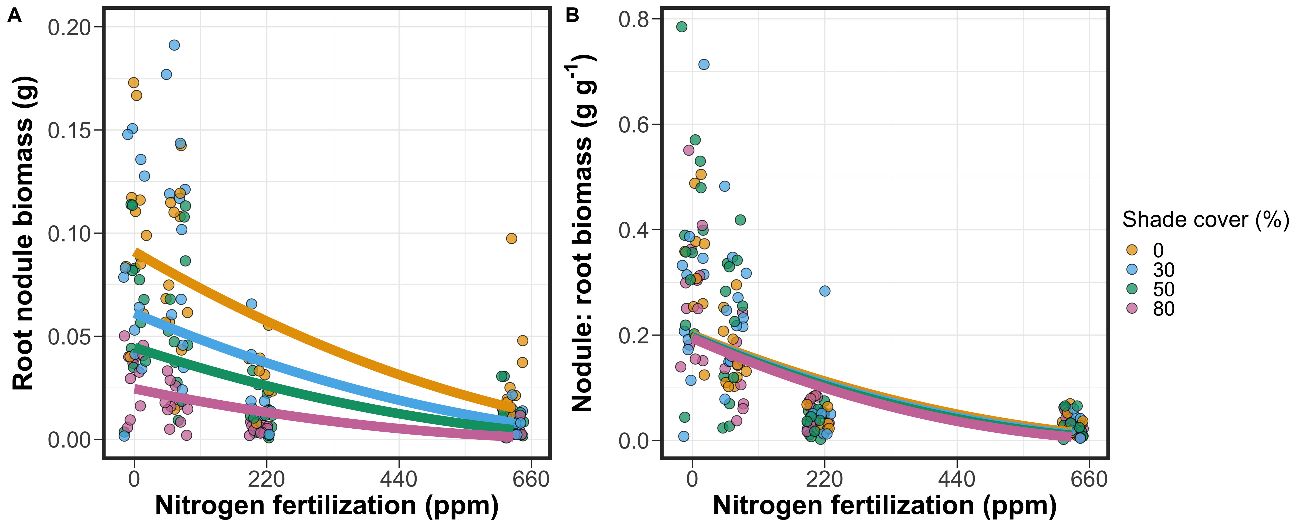
Soybean invested more strongly in direct uptake pathways with increasing nitrogen fertilization (relative to N fixation)
Perkowski et al. (2021) Journal of Experimental Botany

Slide 27
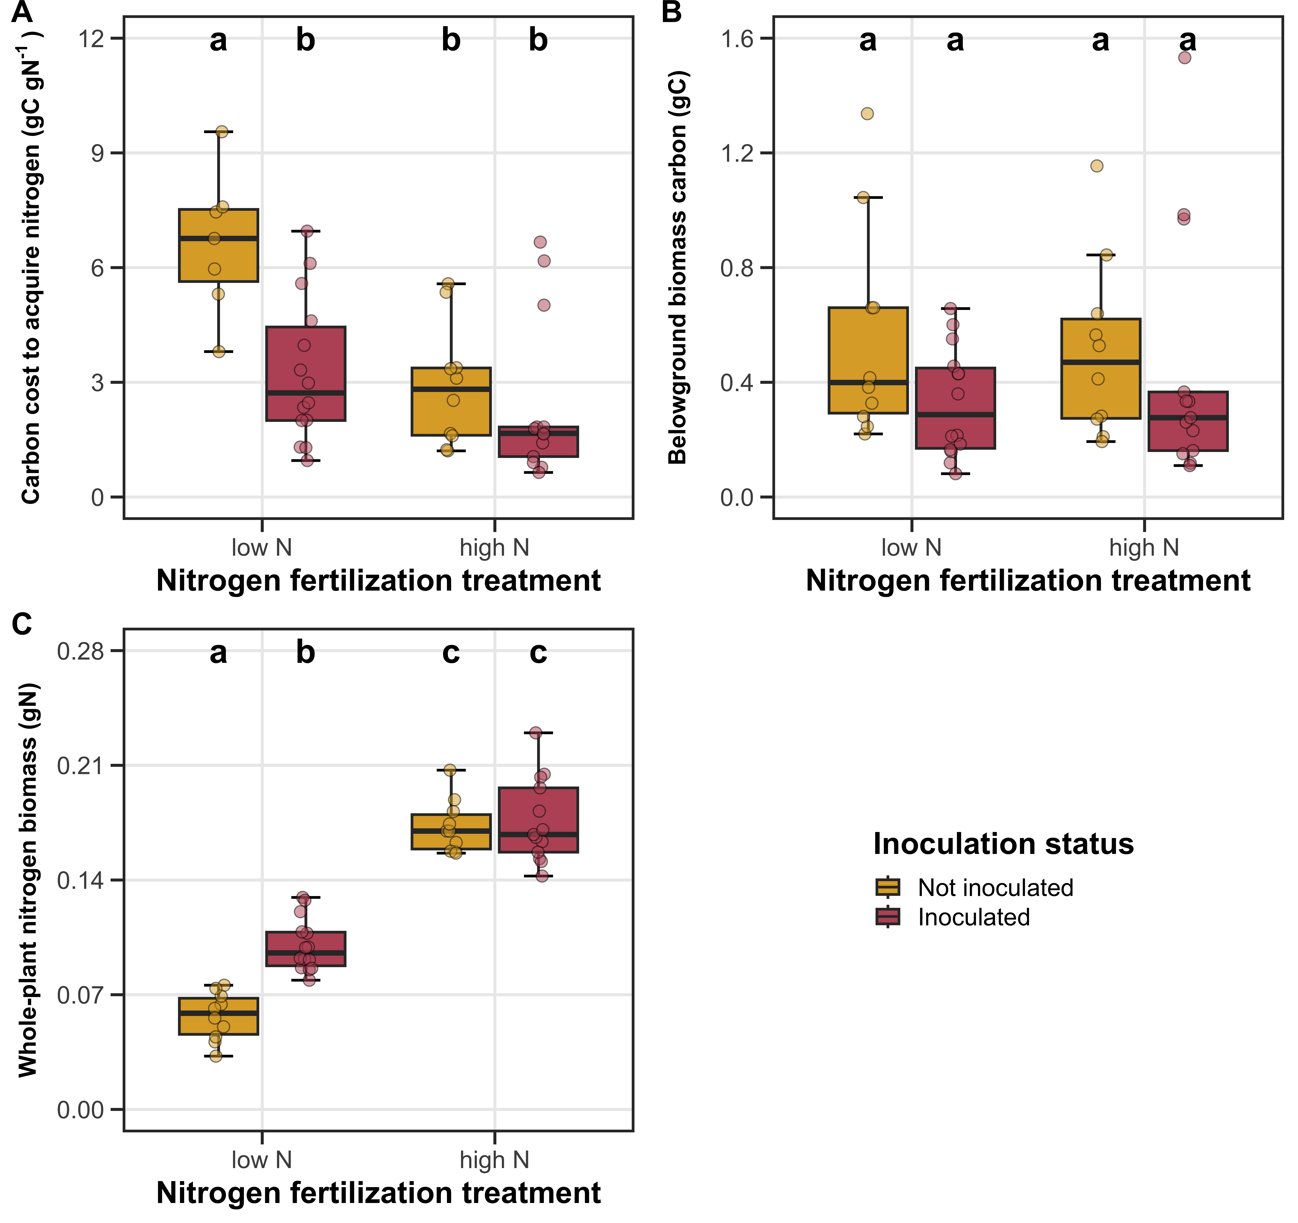
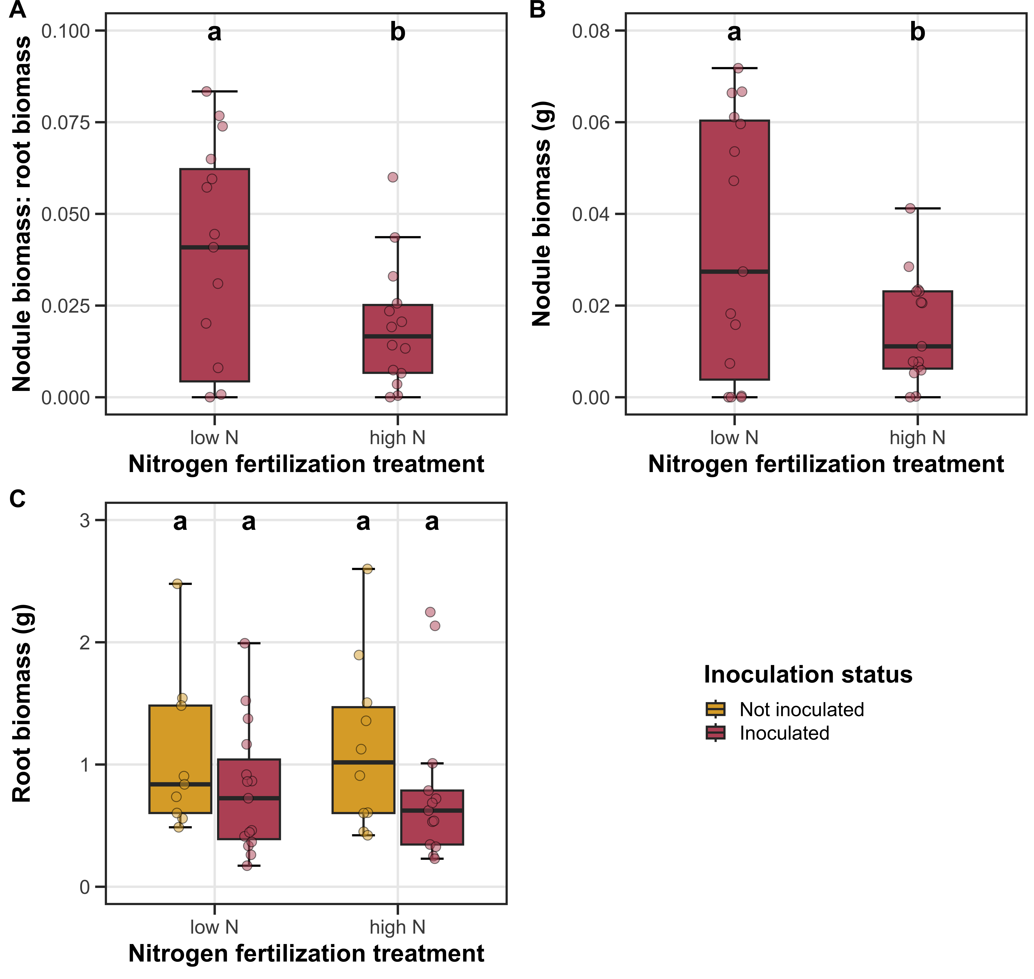
Similar responses are observed when species differences in growth form/duration are controlled!
Perkowski et al. (2024) AoB Plants

Slide 28

Factors that increase demand for building photosynthetic enzymes (e.g., light) may increase the carbon cost to acquire nitrogen
CO₂
Photosynthesis
C_{transfer}
C_{growth}
N_{leaf}
N_{uptake}
N_{available}
Schematic adapted from Brzostek et al. (2014) Biogeosciences
Notes:
Importantly, carbon costs to acquire nitrogen are dynamic and likely change with changing aboveground or belowground environmental conditions.

Slide 29
Increasing light availability increases carbon costs to acquire nitrogen
Perkowski et al. (2021) Journal of Experimental Botany
Notes:
Larger increase in whole plant nitrogen biomass than belowground carbon biomass

Slide 30
Increasing atmospheric CO₂ concentrations also increase carbon costs to acquire nitrogen
Perkowski et al. (in review)

Slide 31
Main takeaways
N acquisition strategy modifies the effects of N availability on carbon costs for nitrogen acquisition
N uptake is maximized by ‘choosing’ the strategy that minimizes C expenditure
Increasing demand to build photosynthetic enzymes increases the cost of acquiring N
Carbon cost to
acquire nitrogen
N availability

Slide 32
Main takeaways
Direct uptake
Nitrogen fixation
N acquisition strategy modifies the effects of N availability on carbon costs for nitrogen acquisition
N uptake is maximized by ‘choosing’ the strategy that minimizes C expenditure
Increasing demand to build photosynthetic enzymes increases the cost of acquiring N
Carbon cost to
acquire nitrogen
N availability

Slide 33
Main takeaways
N acquisition strategy modifies the effects of N availability on carbon costs for nitrogen acquisition
N uptake is maximized by ‘choosing’ the strategy that minimizes C expenditure
Increasing demand to build photosynthetic enzymes increases the cost of acquiring N
Carbon cost to
acquire nitrogen
N demand

Slide 34
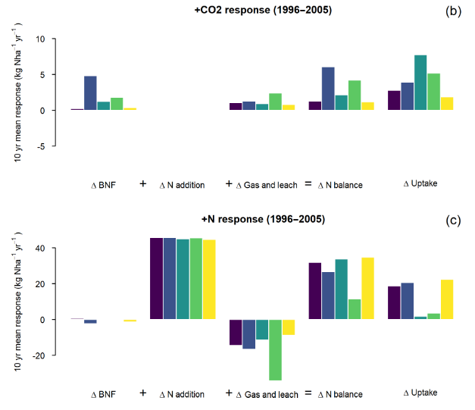
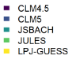
Models rarely include schemes for simulating plant N uptake through its relationship with belowground C allocation
Davies-Barnard et al. (2020) Biogeosciences

Slide 35
What is the role of N availability on plant photosynthetic responses to global change?
Emphasis: plant photosynthetic responses to elevated atmospheric CO₂ concentrations

Slide 36
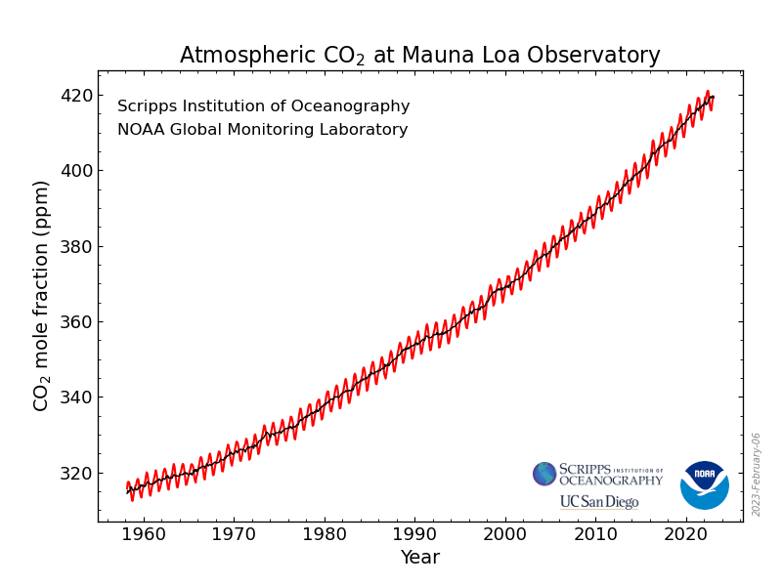
https://gml.noaa.gov/ccgg/trends/

Slide 37
33% increase in CO₂ concentration since 1960
61% of this increase has occurred since 1990
https://gml.noaa.gov/ccgg/trends/

Slide 38
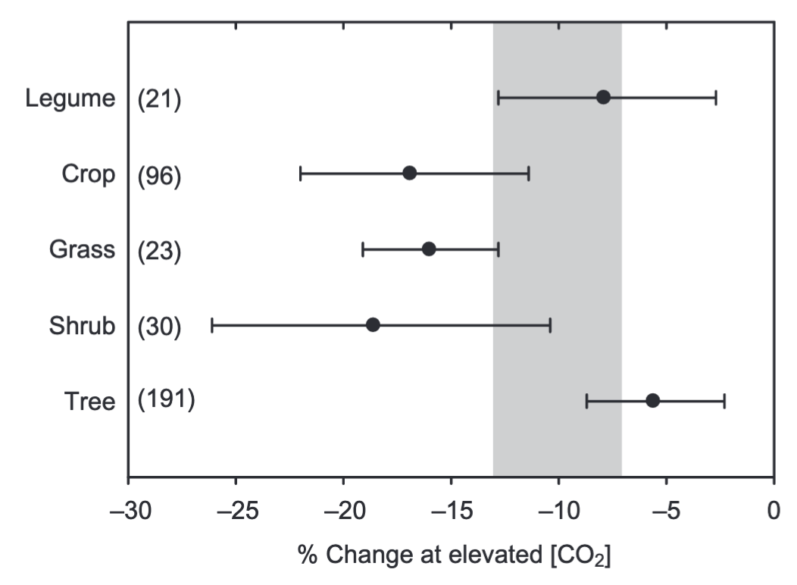
Plants grown under elevated CO₂ exhibit reductions in photosynthetic capacity
Photosynthetic capacity
Ainsworth & Rogers (2007) PC&E

Slide 39
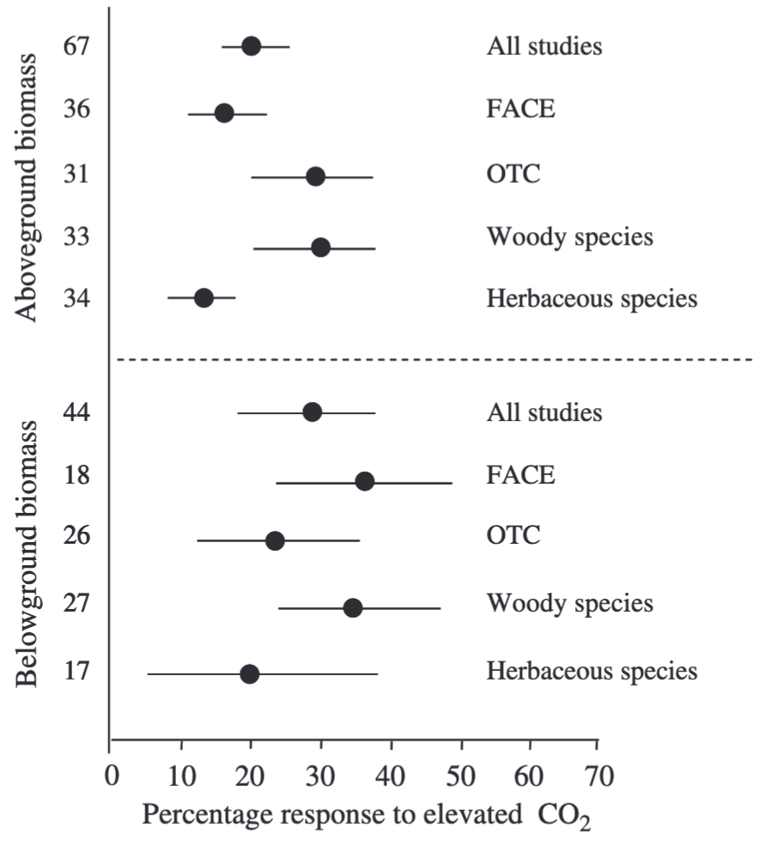
Reduced photosynthetic capacity under elevated CO₂ often corresponds with increased whole-plant growth
Aboveground biomass
Belowground biomass
de Graaf et al. (2006) Global Change Biology

Slide 40
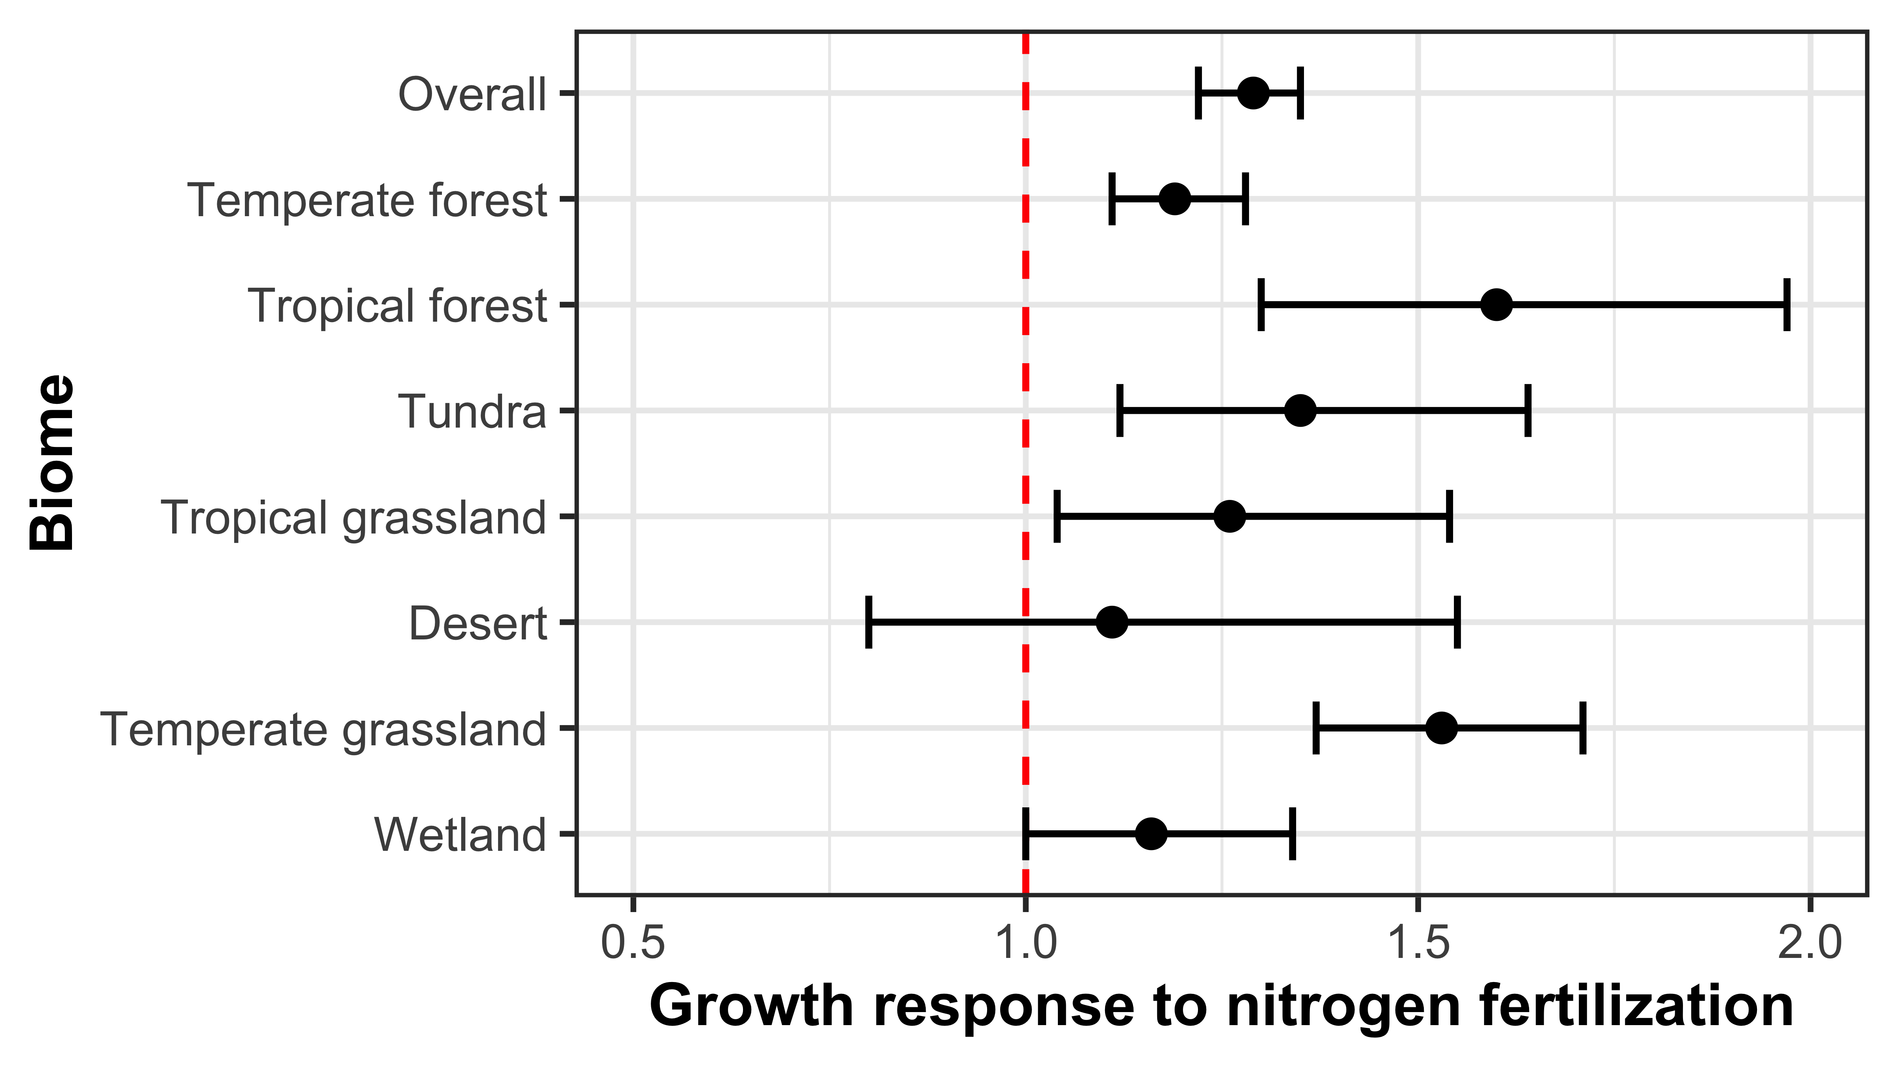
Some have hypothesized that nitrogen availability regulates plant responses to elevated CO₂
Figure adapted from Table 1 in LeBauer & Treseder (2008) Ecology
Notes:
The idea behind this is that nitrogen availability has been shown to limit net primary productivity globally

Slide 41
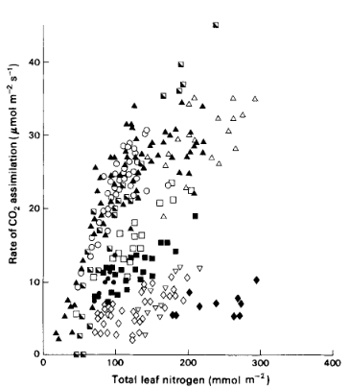
Some have hypothesized that nitrogen availability regulates plant responses to elevated CO₂
Figure adapted from Table 1 in LeBauer & Treseder (2008) Ecology
Evans (1989) Photosynthesis Research
Notes:
And that this response might be at least partly driven by positive relationships between soil nitrogen availability, leaf nitrogen content, and photosynthetic capacity

Slide 42
Some have hypothesized that nitrogen availability regulates plant responses to elevated CO₂
Increased demand to build and maintain photosynthetic enzymes
might deplete plant-available soil N pools
Figure adapted from Table 1 in LeBauer & Treseder (2008) Ecology
Evans (1989) Photosynthesis Research
Notes:
- Under elevated CO2, some have hypothesized that increased demand to build and maintain photosynthetic enzymes
- might increase plant nitrogen uptake rates that should eventually deplete plant-available soil N pools as nitrogen becomes stored in longer living tissues

Slide 43
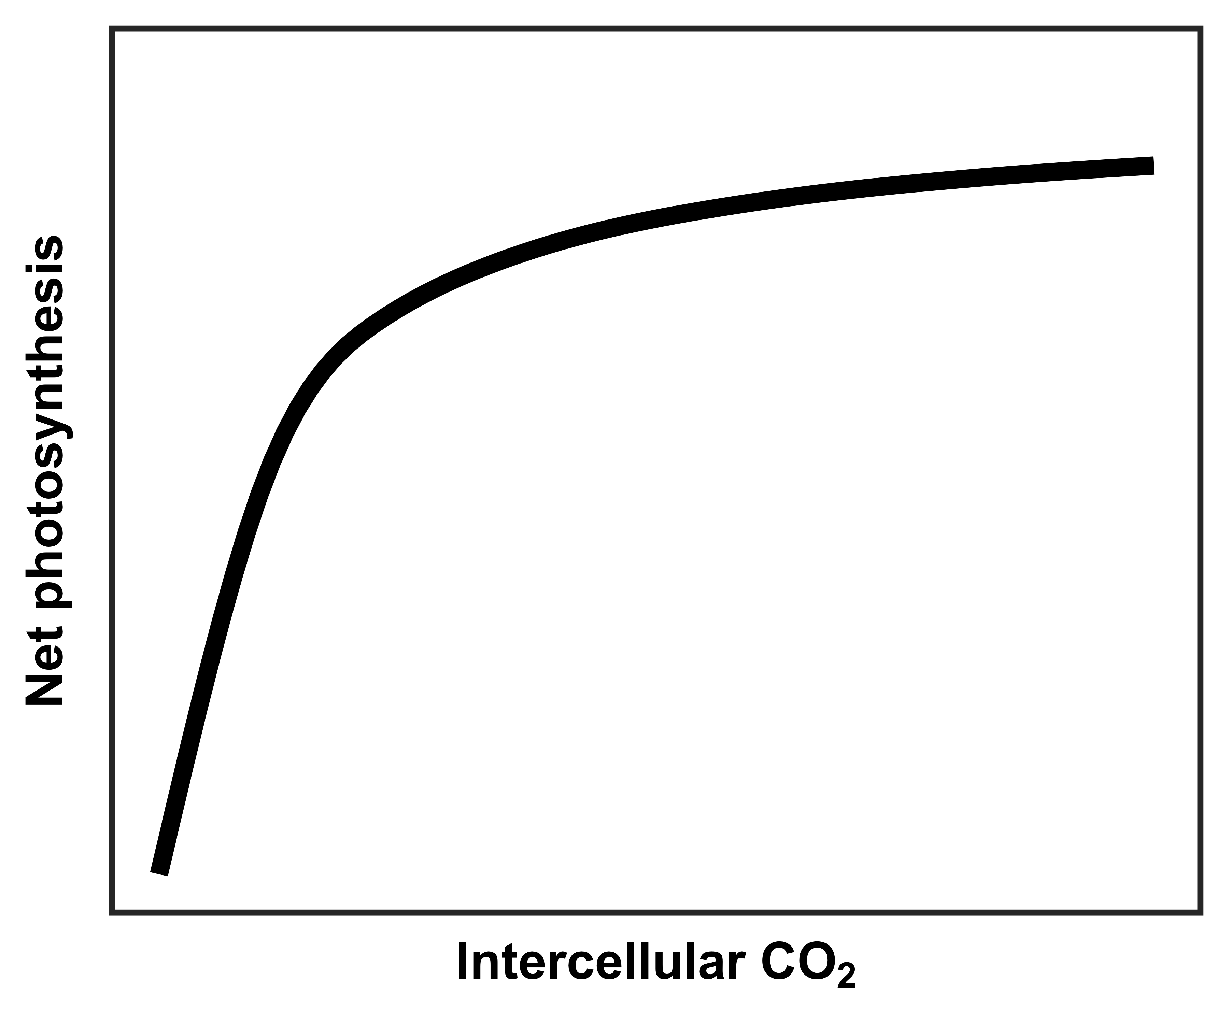
However, an alternative hypothesis suggests that plant demand to build and maintain photosynthetic enzymes drives the leaf response to CO₂
Figure adapted from Moore et al. (1999) PC&E
Notes:
Plants respond instantaneously to changes in intercellular CO2

Slide 44
However, an alternative hypothesis suggests that plant demand to build and maintain photosynthetic enzymes drives the leaf response to CO₂
Rubisco-limited photosynthesis
(A_{c})
Figure adapted from Moore et al. (1999) PC&E
Notes:
Plants respond instantaneously to changes in intercellular CO2
Under low CO2 concentrations, net photosynthesis linearly increases due to net photosynthesis rates being limited by CO2 and Rubisco carboxylation rates

Slide 45
However, an alternative hypothesis suggests that plant demand to build and maintain photosynthetic enzymes drives the leaf response to CO₂
RuBP-limited photosynthesis
(A_{j})
Rubisco-limited photosynthesis
(A_{c})
Figure adapted from Moore et al. (1999) PC&E
Notes:
As intercellular CO2 concentrations increase, leaves become saturated with CO2 substrate.
Thus, net photosynthesis rates begin to become limited by electron transport for RuBP regeneration, which is a function of light availability

Slide 46
However, an alternative hypothesis suggests that plant demand to build and maintain photosynthetic enzymes drives the leaf response to CO₂
RuBP-limited photosynthesis
(A_{j})
Rubisco-limited photosynthesis
(A_{c})
net photosynthesis
at ambient CO₂
A_{c} = A_{j}
Figure adapted from Moore et al. (1999) PC&E
Notes:
Optimality theory predicts that plants should optimally allocate nitrogen to Rubisco to maximize nitrogen allocation to other structures and functions
such that
net photosynthesis rates are equally limited by Rubisco- and RuBP-limited photosynthesis rates (Ac = Aj)​

Slide 47
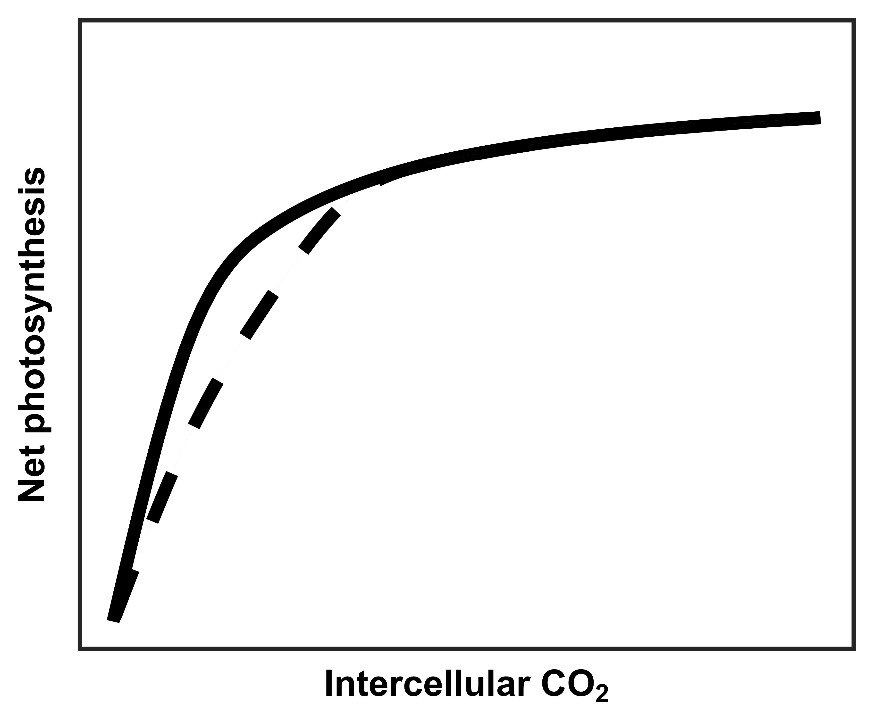
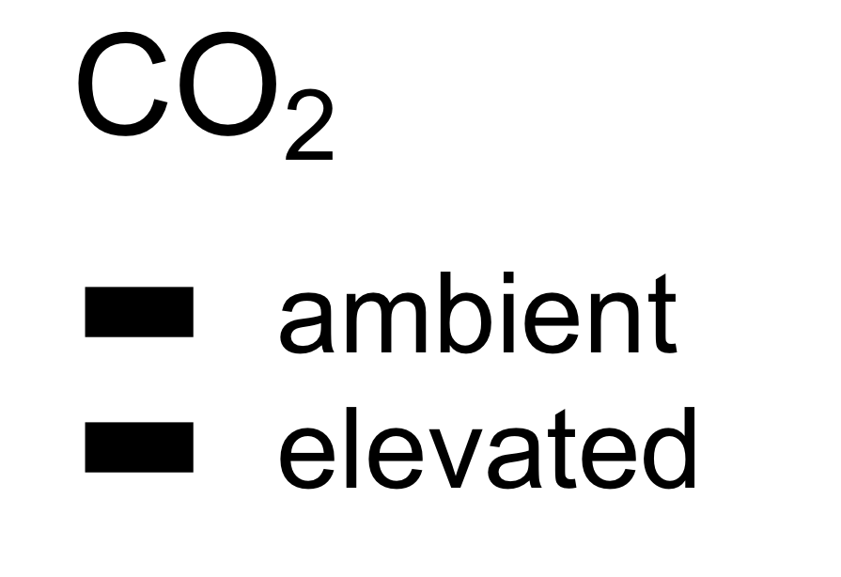
However, an alternative hypothesis suggests that plant demand to build and maintain photosynthetic enzymes drives the leaf response to CO₂
RuBP-limited photosynthesis
(A_{j})
Rubisco-limited photosynthesis
(A_{c})
net photosynthesis
at ambient CO₂
A_{c} = A_{j}
net photosynthesis
at elevated CO₂
Figure adapted from Moore et al. (1999) PC&E
Notes:
- We expect these same optimal resource investments to occur under elevated CO2, but notice that the curve looks a bit different
- The reduced initial slope, indicative of the maximum rate of Rubisco carboxylation, extends the portion of the curve that is limited by Rubisco carboxylation and CO2,
- increasing the photosynthesis rate and the intercellular CO2 threshold where Rubisco limited photosynthesis equals RuBP limited photosynthesis

Slide 48
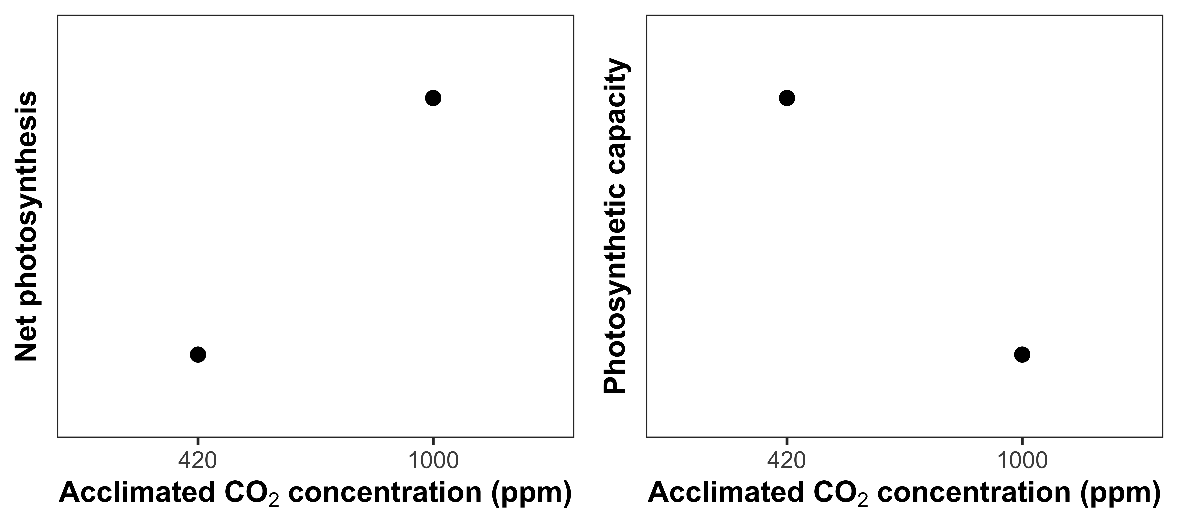
Optimal resource investment to photosynthetic enzymes increases leaf photosynthesis at lower photosynthetic capacity
Reduced photosynthetic capacity
Increased net photosynthesis
rate
Notes:
- These patterns should result in plants grown under elevated CO2 having greater net photosynthesis rates and reduced photosynthetic capacity,
- perhaps as a function of reduced leaf nitrogen allocation to photosynthetic tissue and increased nitrogen use efficiency

Slide 49
Nitrogen limitation
hypothesis
Optimality
hypothesis
eCO₂
Photosynthetic capacity
eCO₂
Photosynthetic capacity
Soil N supply
Whole-plant growth
Soil N supply
Whole-plant growth
= net positive effect
= net negative effect
= null effect
Notes:
As a reminder, there are two primary hypotheses of note here:

Slide 50
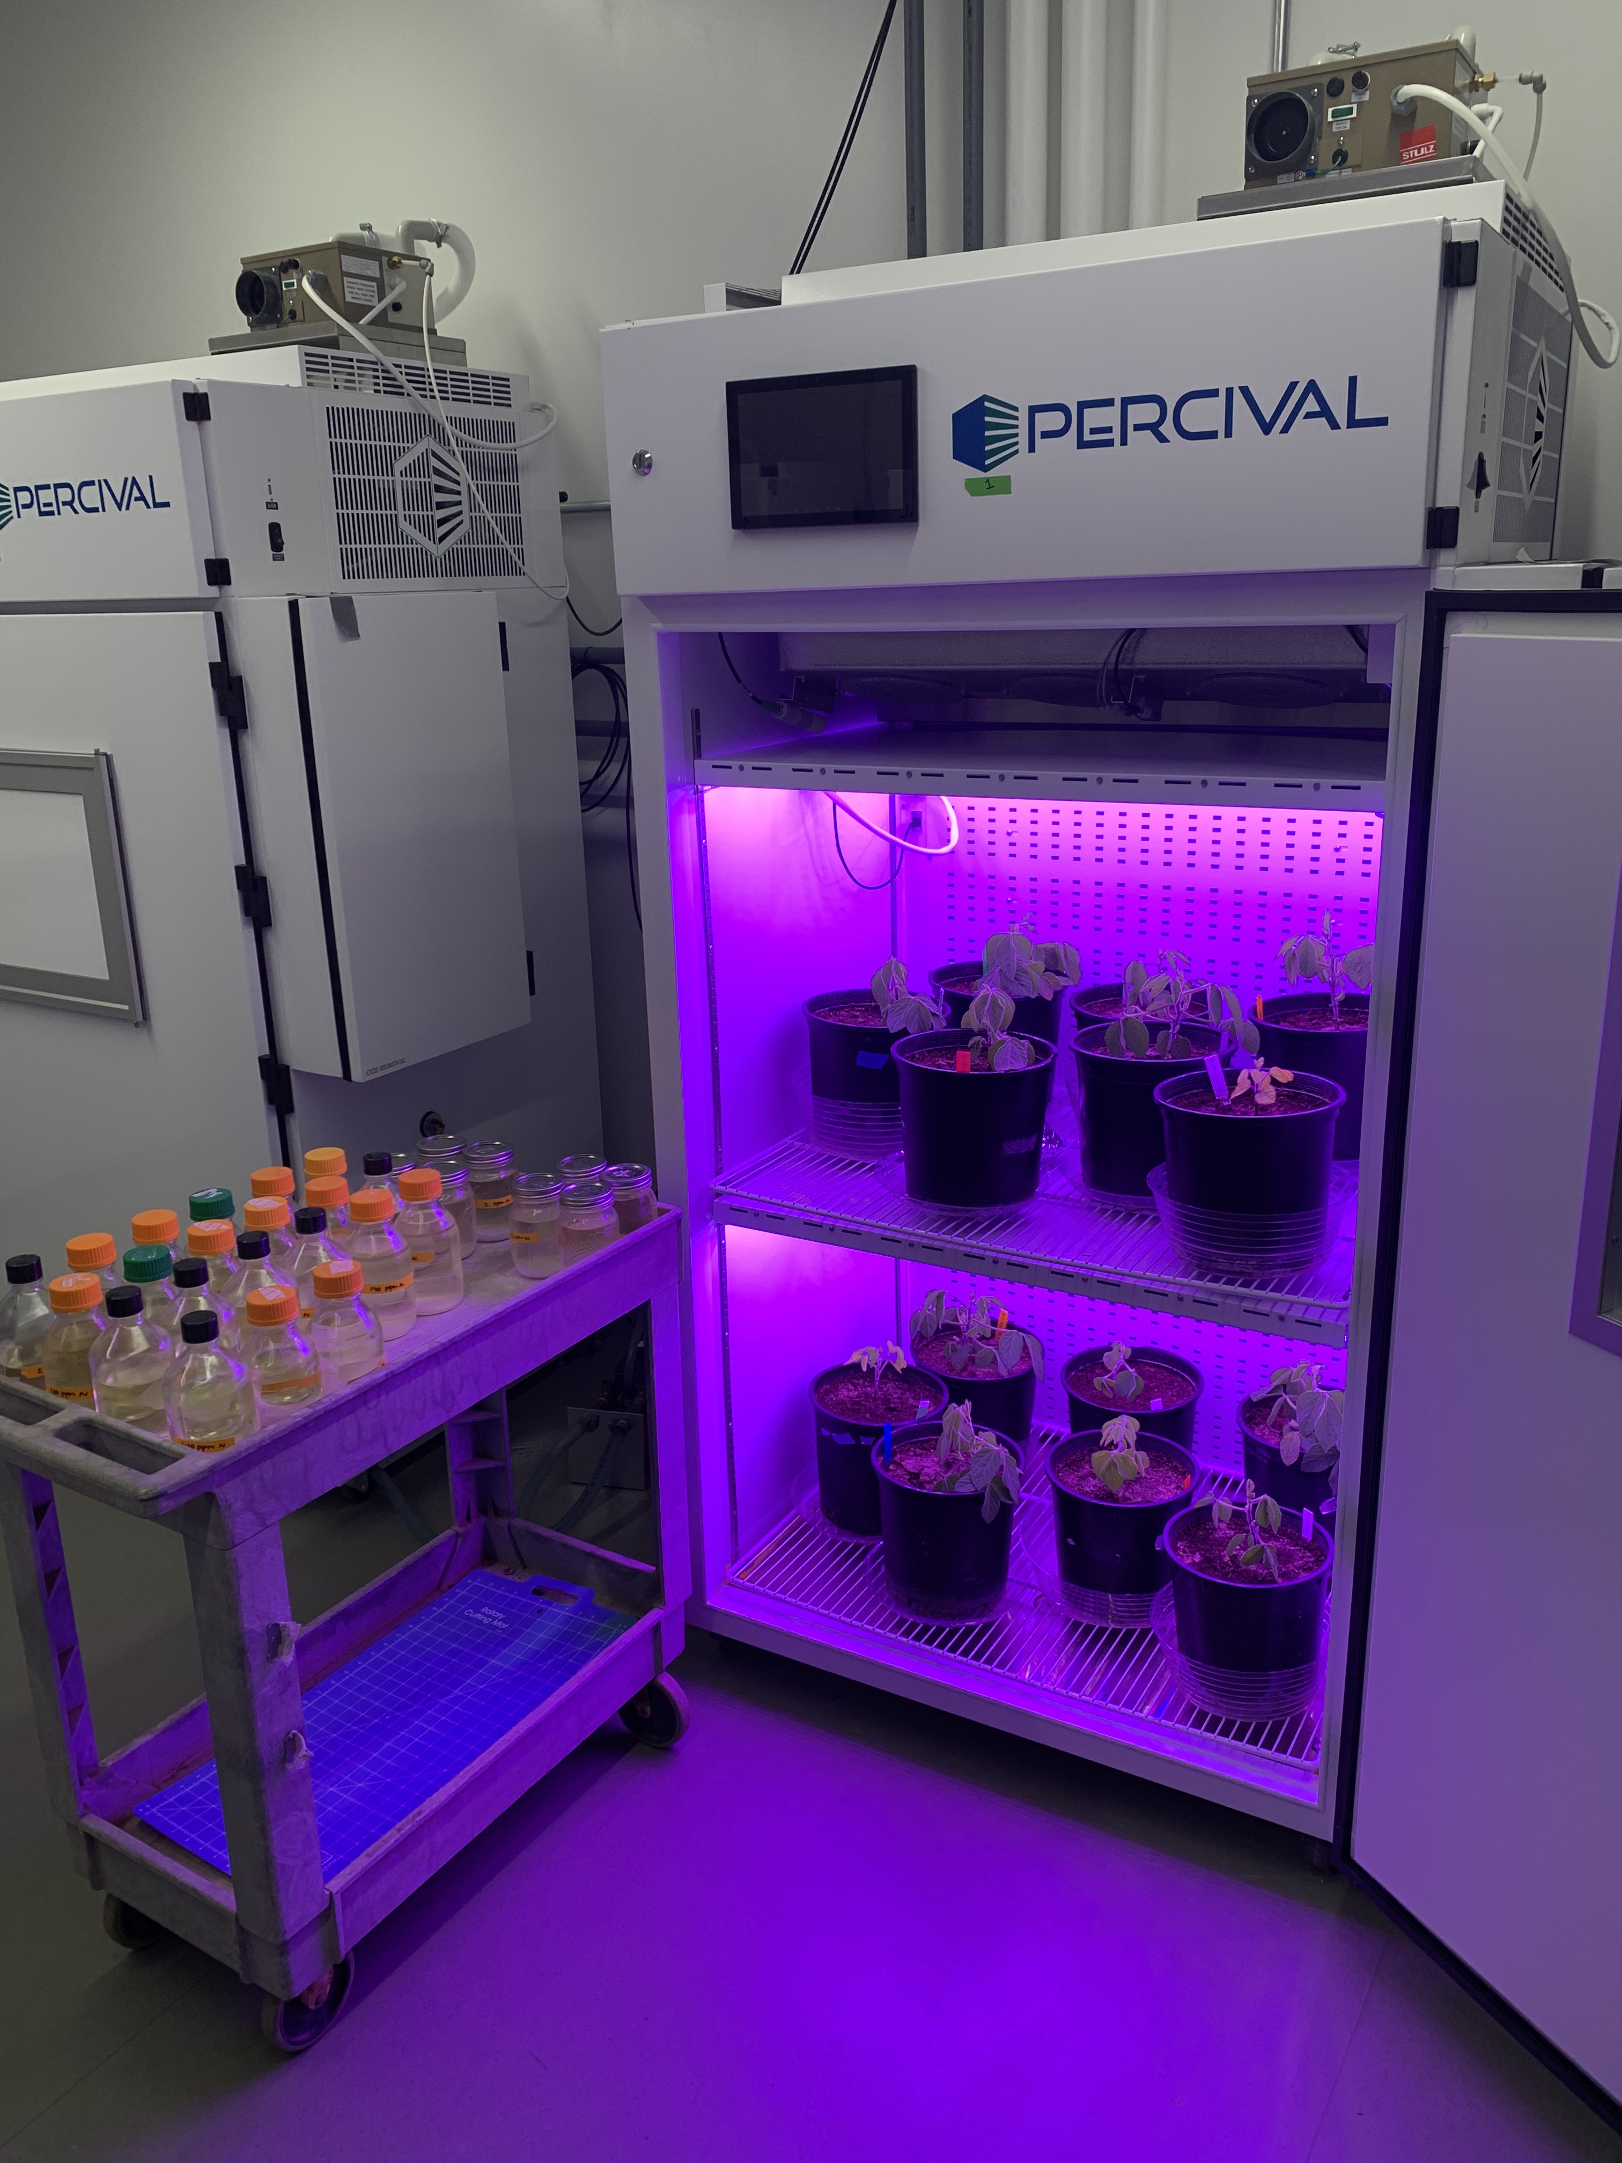
Experiment setup
Acquisition strategy
Soil N treatments
0 ppm N
+ BNF
35 ppm N
- BNF
70 ppm N
105 ppm N
CO₂ treatments
140 ppm N
210 ppm N
ambient (420 ppm)
280 ppm N
elevated (1000 ppm)
350 ppm N
630 ppm N
Perkowski et al. (in prep)

Slide 51
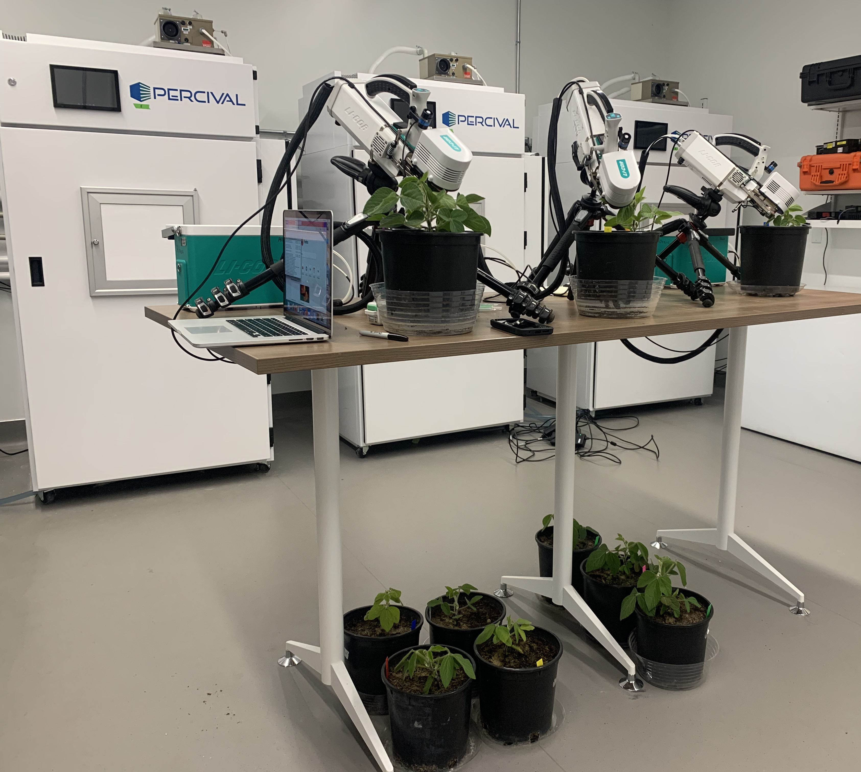
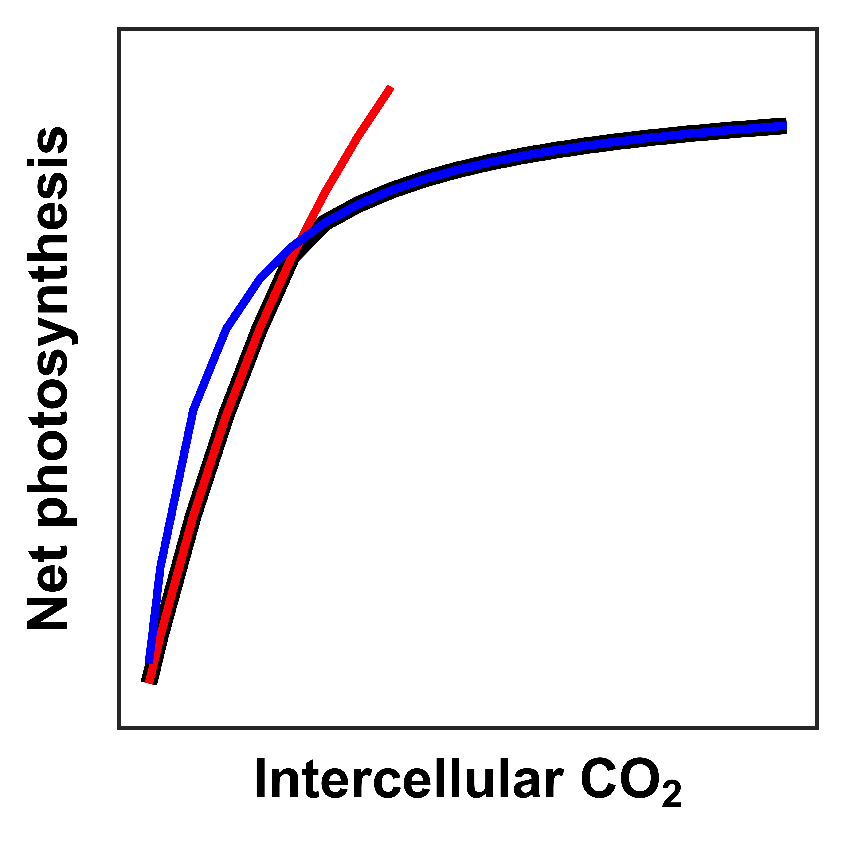
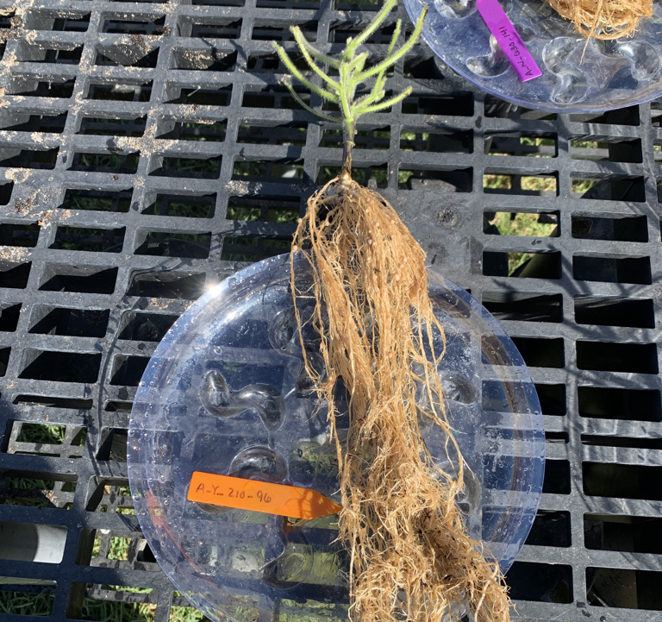
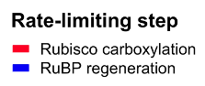
Measurements
Photosynthetic capacity
V_{cmax25}
J_{max25}
J_{max25}:V_{cmax25}
Total biomass
% leaf N derived from atmosphere
Perkowski et al. (in prep)

Slide 52
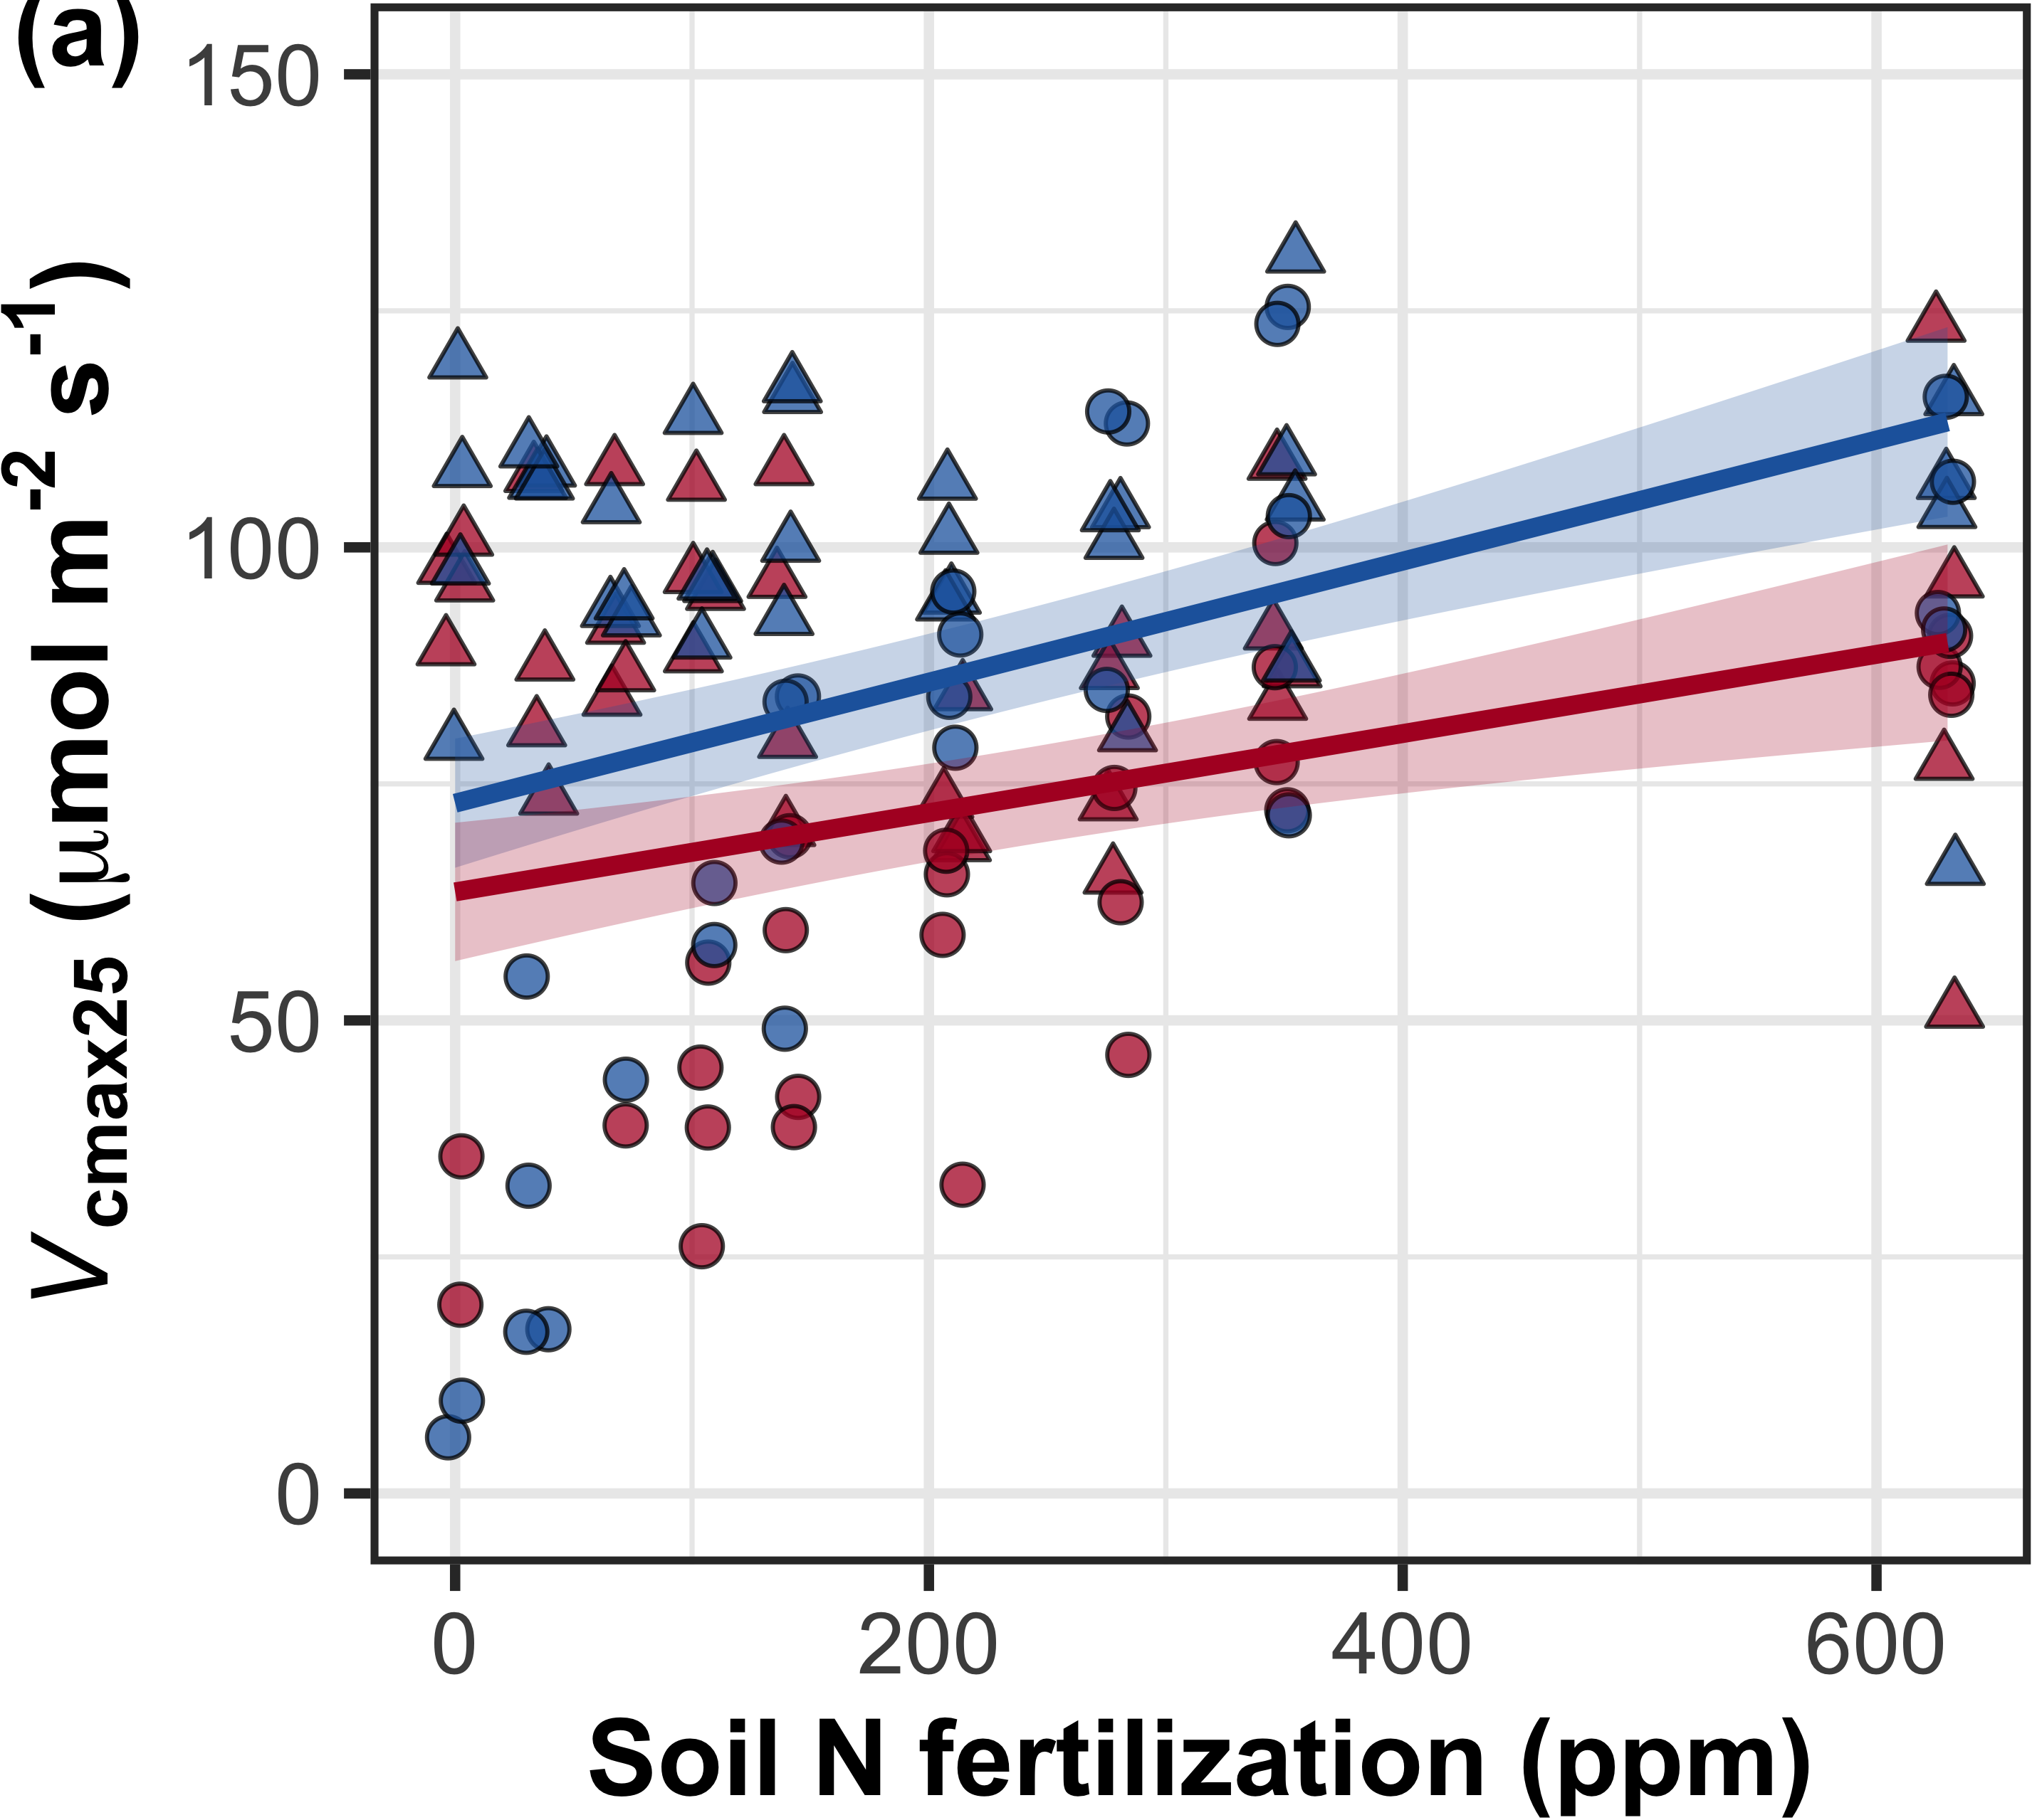
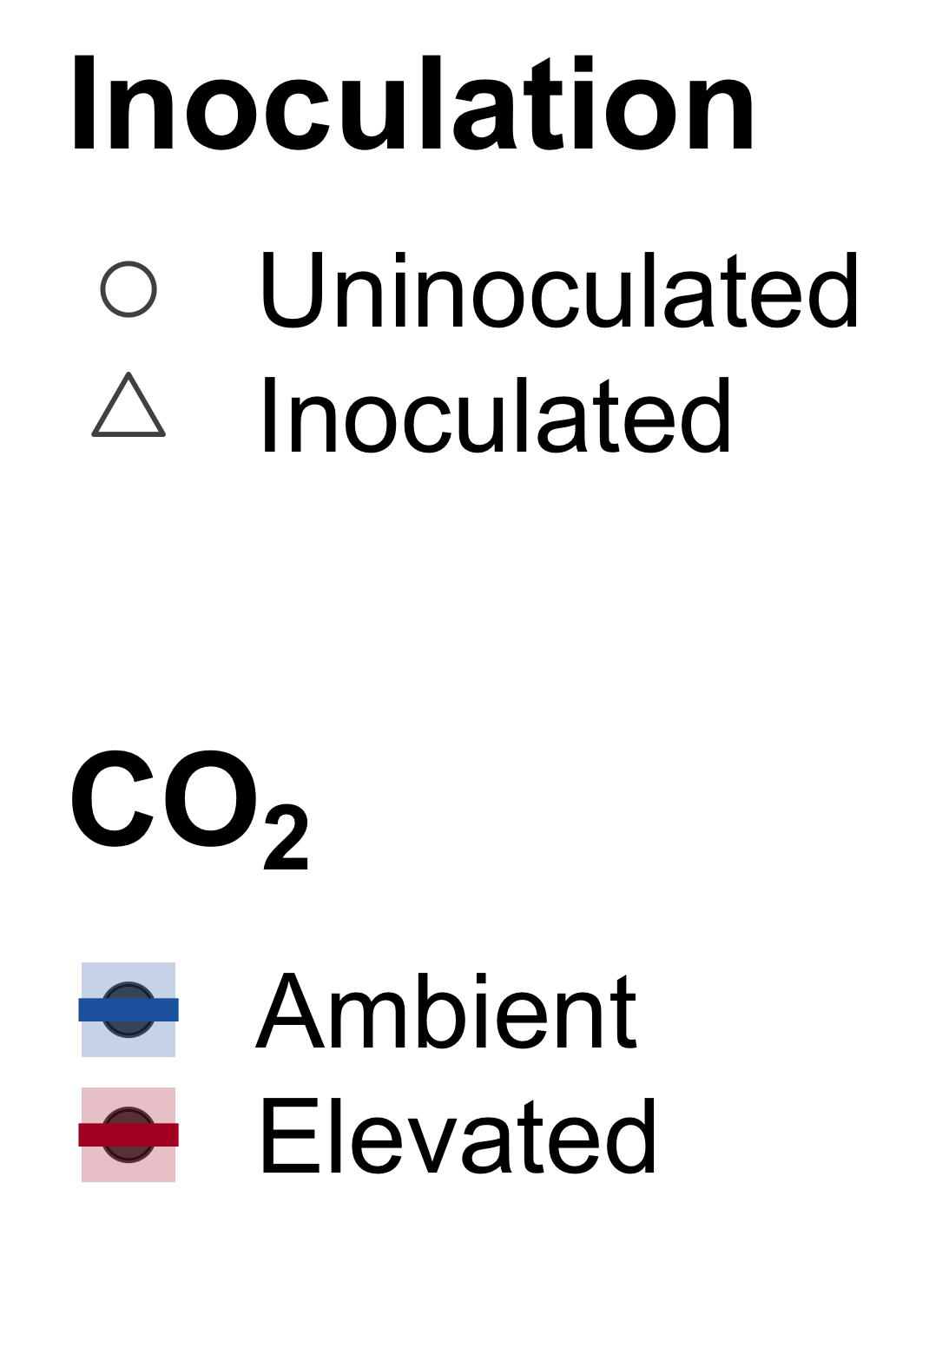
Increasing fertilization did not modify the reduction in photosynthetic capacity under elevated CO₂
CO₂: | p<0.001
Fertilization (N): | p<0.001
Inoculation (I): | p<0.001
CO₂*N interaction: | NS
CO₂*I interaction: | NS
N*I interaction: | p<0.001
CO₂
CO₂
Notes:
- Elevated CO2 reduced leaf biochemical process rates
- Soil nitrogen fertilization generally increased leaf biochemical process rates, but the slope of this relationship was similar between both CO2 treatments
- Indicates that the reduction in photosynthetic capacity under elevated CO2 was independent of fertilization

Slide 53
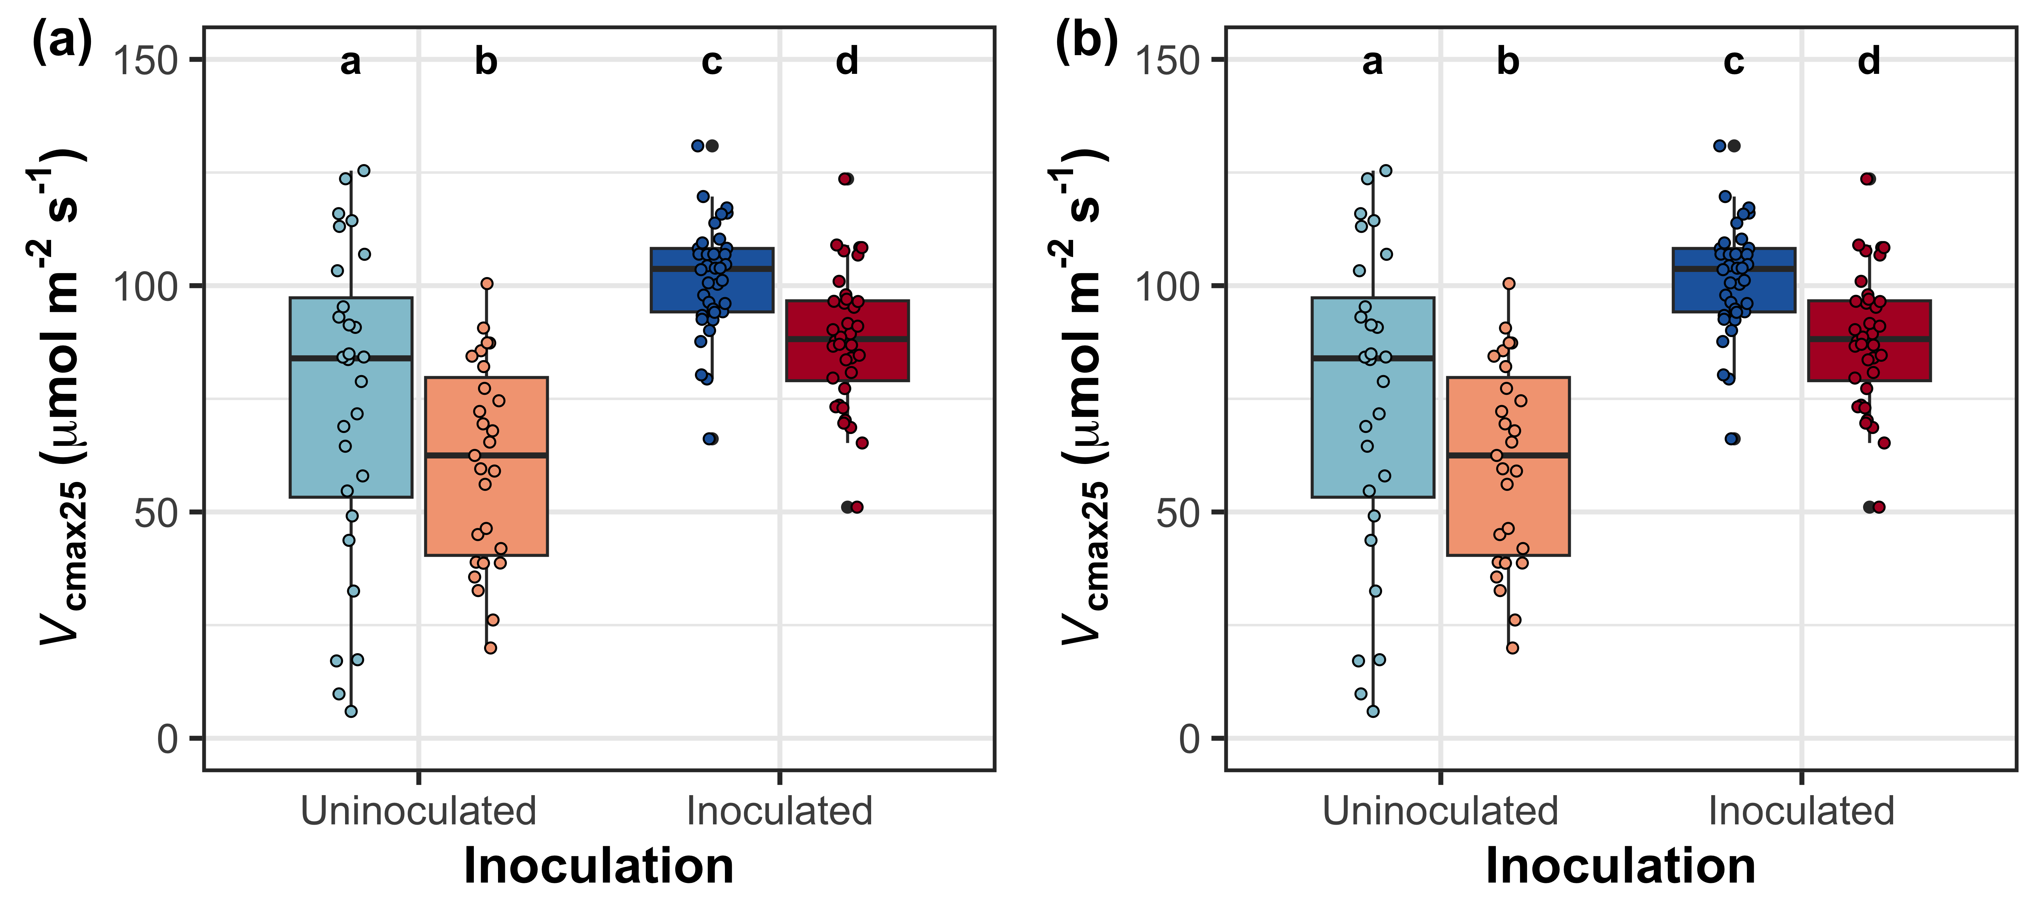
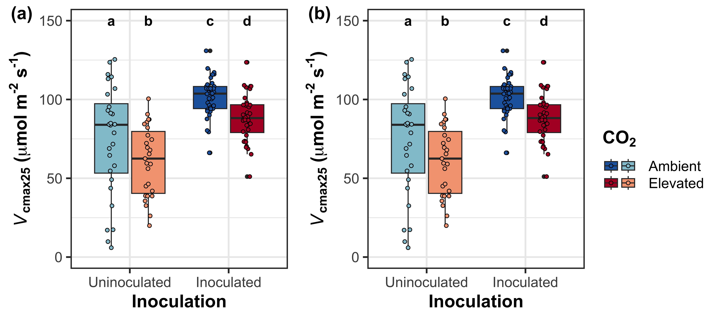
Inoculation also did not modify the reduction in photosynthetic capacity under elevated CO₂
CO₂: | p<0.001
Fertilization (N): | p<0.001
Inoculation (I): | p<0.001
CO₂*N interaction: | NS
CO₂*I interaction: | NS
N*I interaction: | p<0.001
CO₂
CO₂
Notes:
- Inoculation with symbiotic nitrogen fixing bacteria generally increased photosynthetic capacity,
- but the effect of elevated CO2 was similar between inoculation treatments,
- suggesting that the CO2 effect was also independent of inoculation

Slide 54
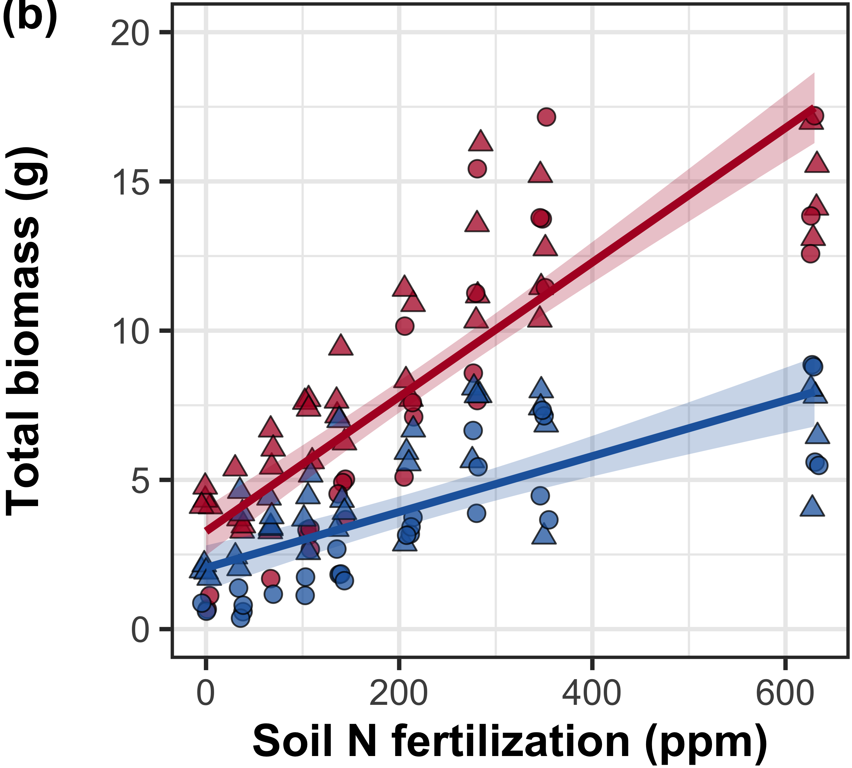
Increasing fertilization increased the positive effect of elevated CO₂ on whole-plant growth
CO₂: | p<0.001
Fertilization (N): | p<0.001
Inoculation (I): | p<0.001
CO₂*N interaction: | p<0.001
CO₂*I interaction: | NS
CO₂
CO₂
Perkowski et al. (in prep)
Notes:
- Despite reductions in photosynthetic capacity and leaf nitrogen allocation at the leaf level,
- whole plant growth was greater under elevated CO2
- Increasing fertilization increased total biomass, an effect that was stronger under elevated CO2 than ambient CO2
- This result suggests that nitrogen availability plays an important role in regulating whole plant responses to elevated CO2

Slide 55
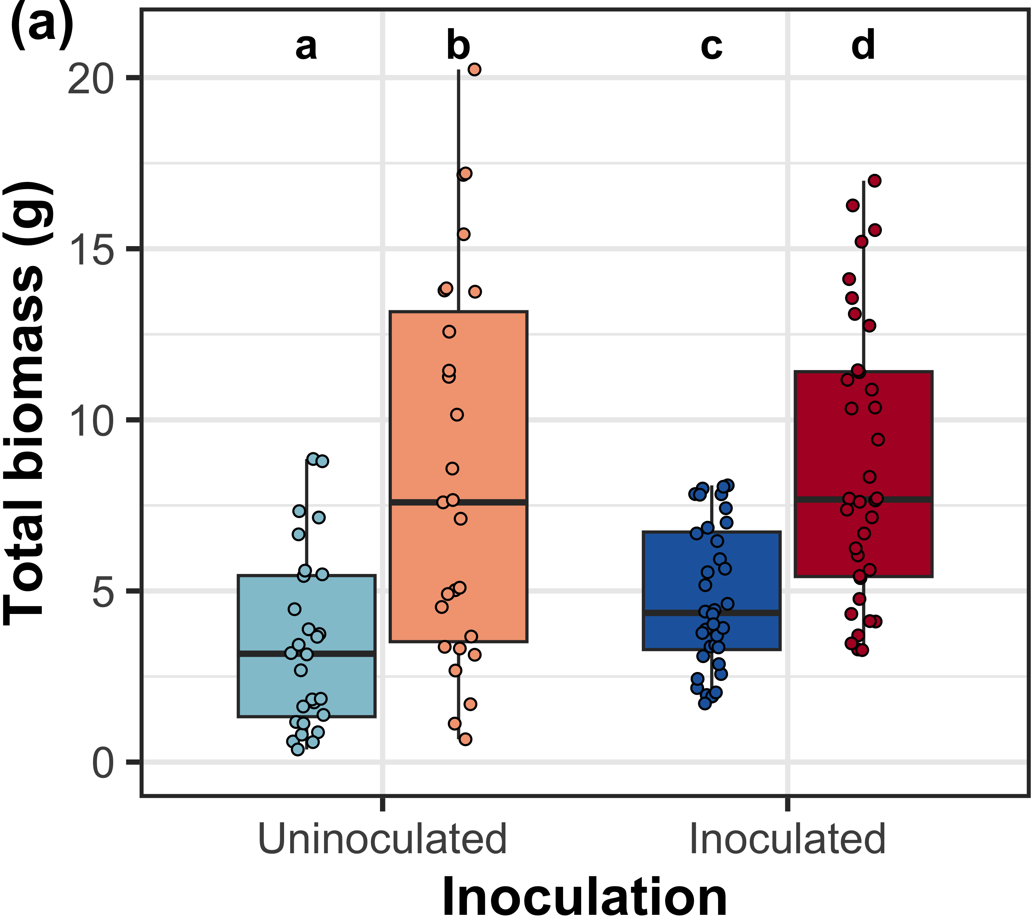
Inoculation did not modify the positive effect of eCO₂ on total biomass
CO₂: | p<0.001
Fertilization (N): | p<0.001
Inoculation (I): | p<0.001
CO₂*N interaction: | p<0.001
CO₂*I interaction: | NS
CO₂
CO₂
Notes:
- Inoculation with symbiotic nitrogen fixing bacteria generally increased total biomass,
- but the effect of elevated CO2 was similar between inoculation treatments,
- suggesting that the CO2 effect was independent of inoculation

Slide 56
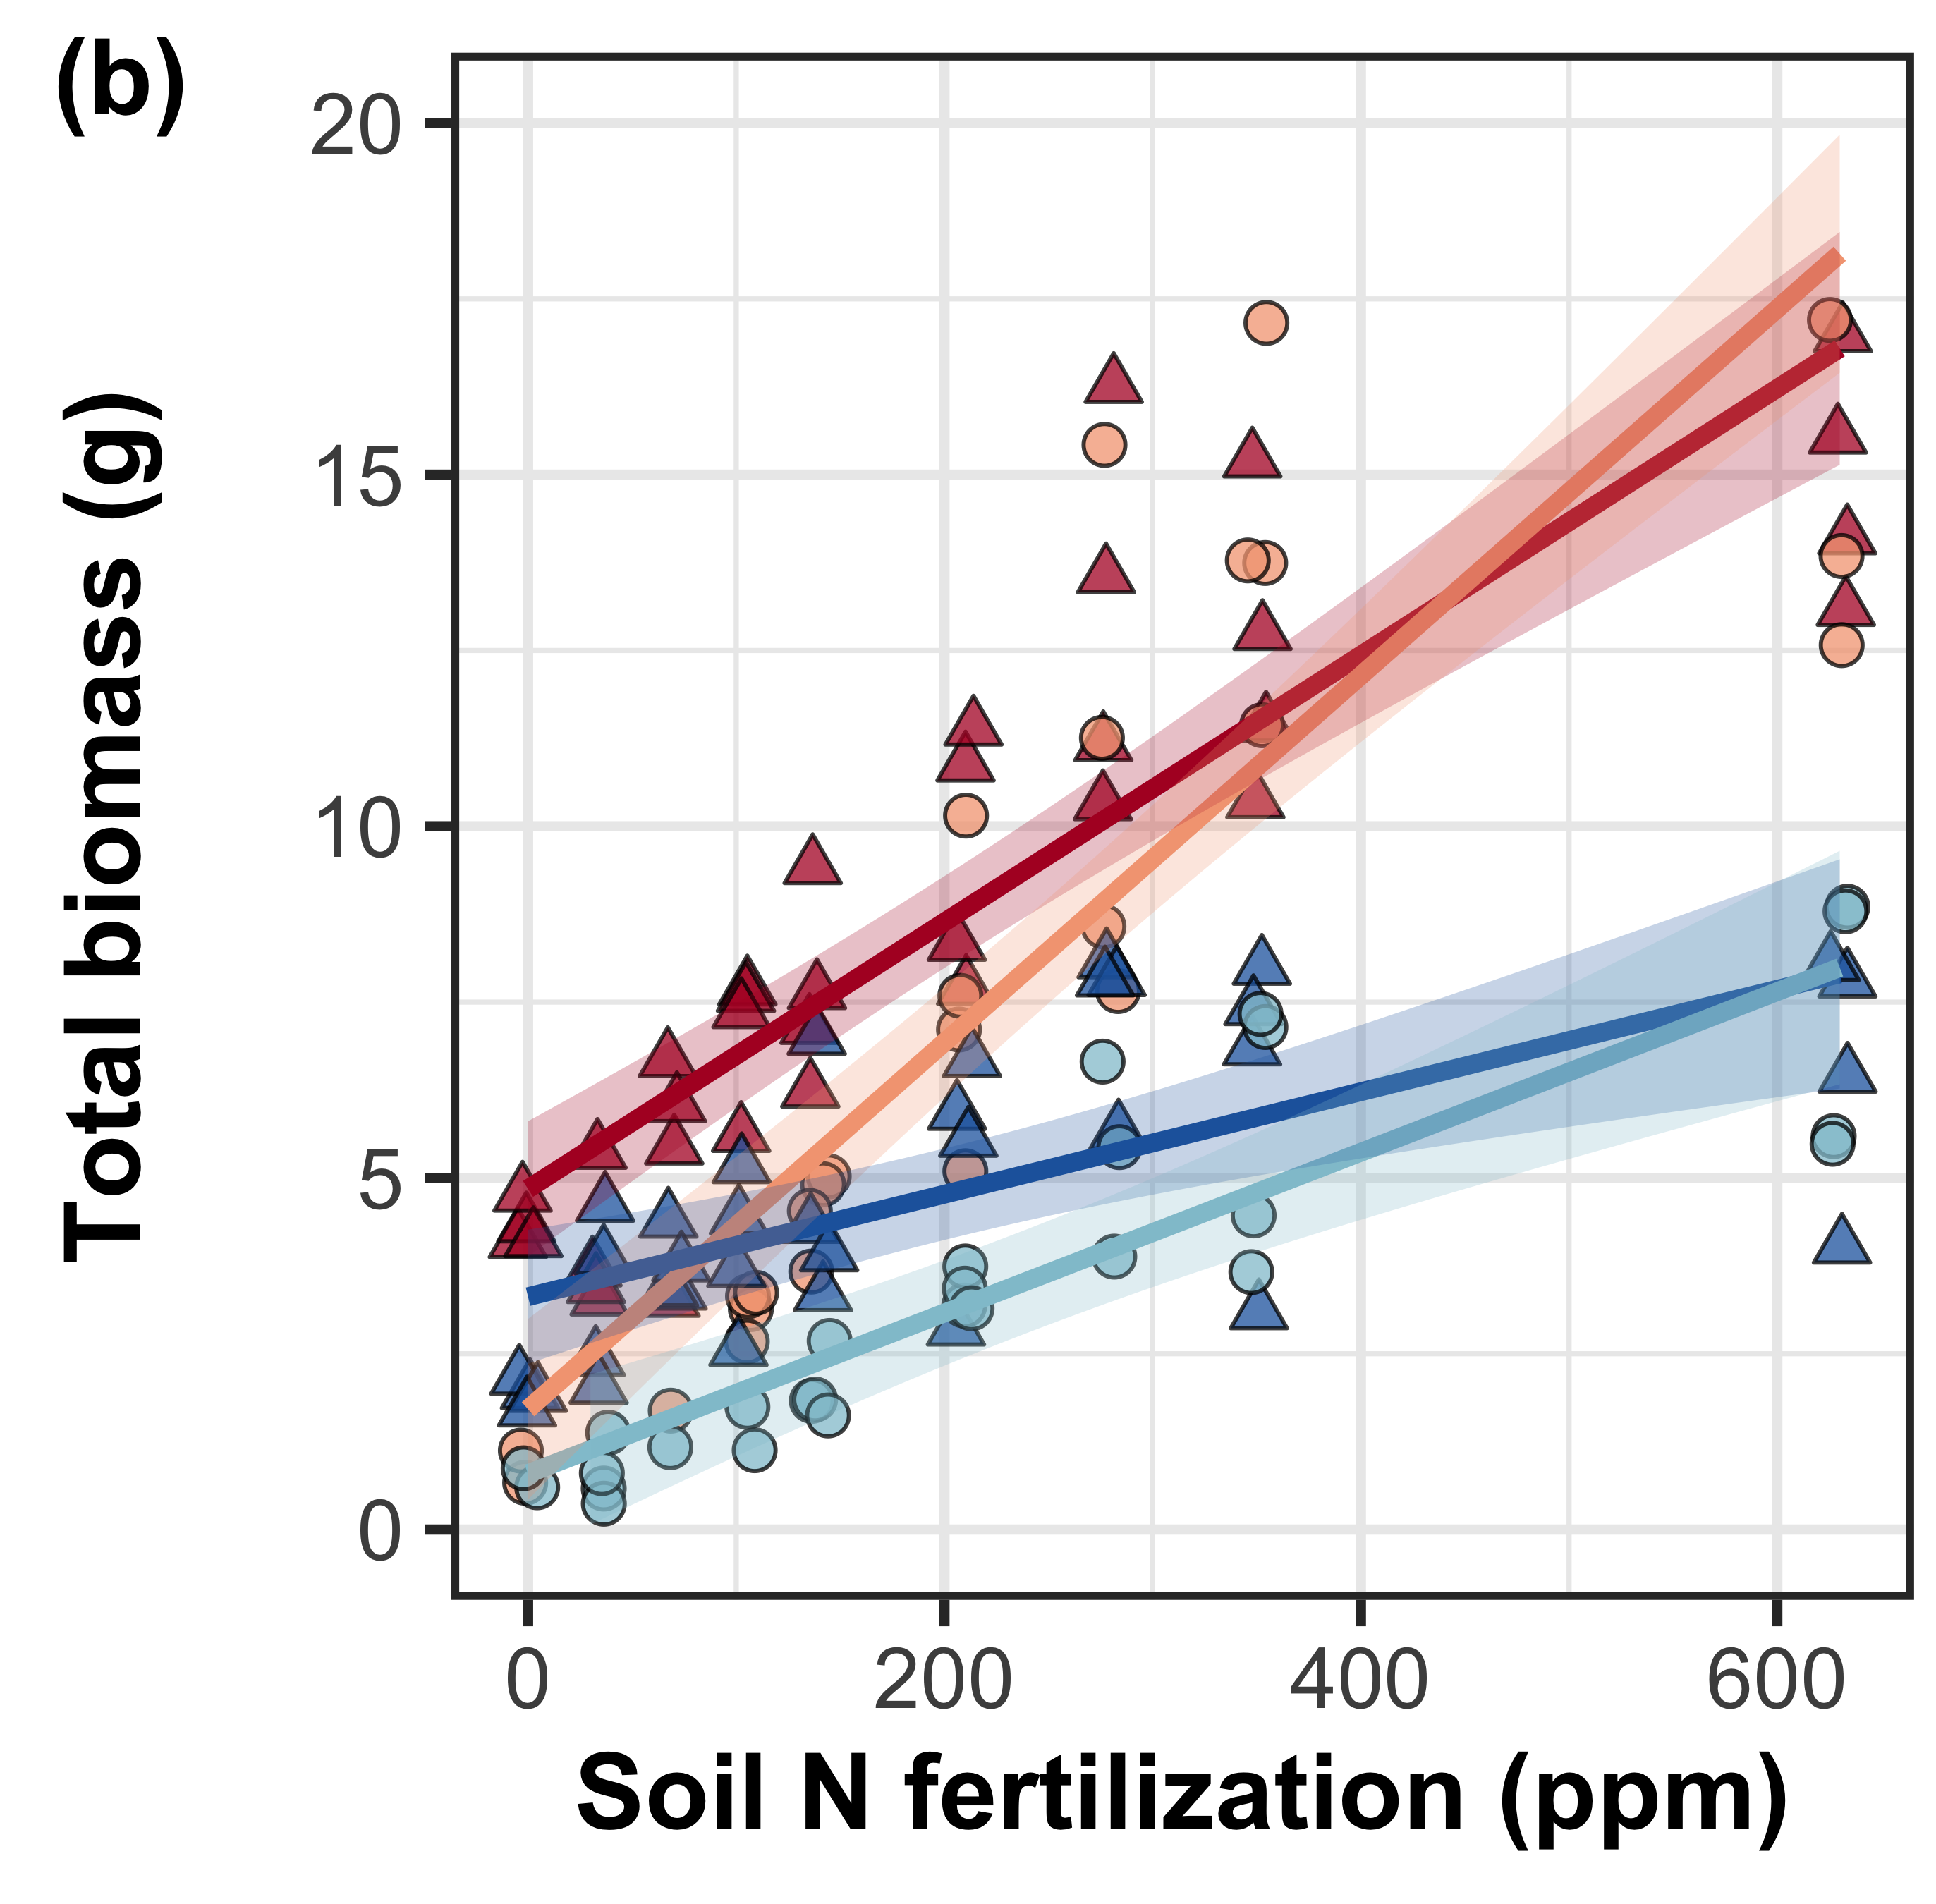
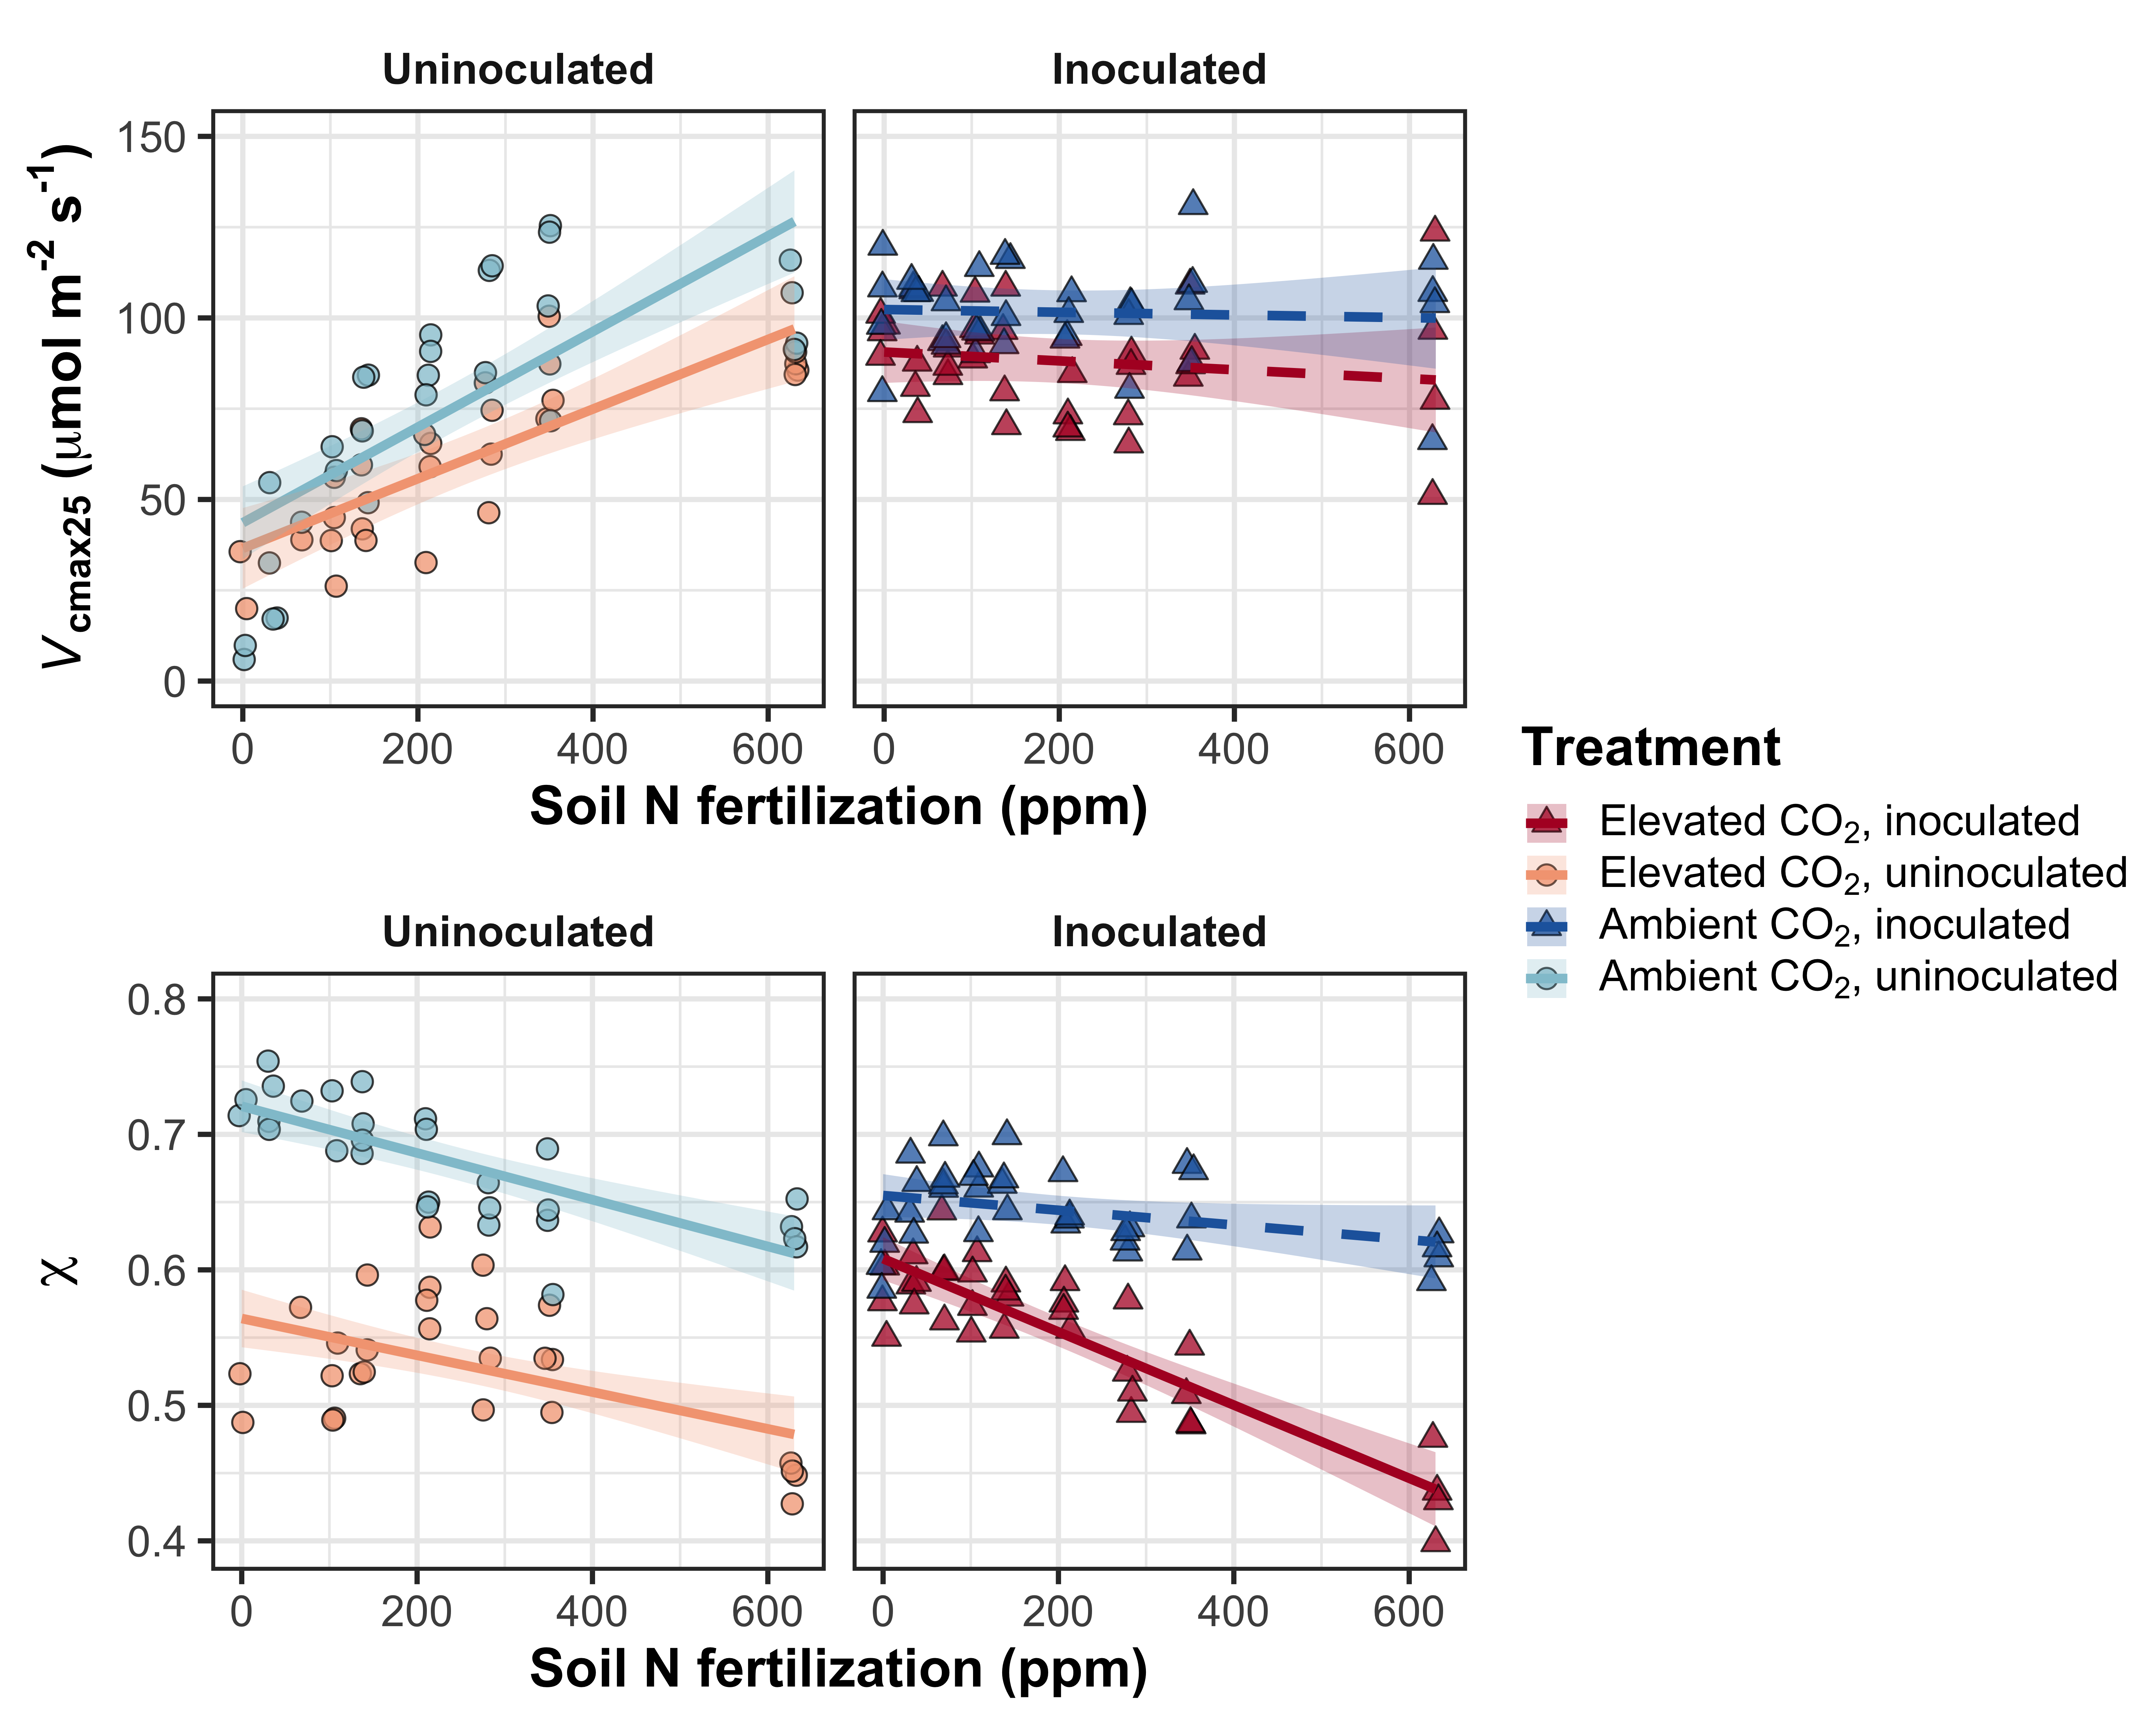
However, inoculated plants had greater total biomass under low fertilization
CO₂: | p<0.001
Fertilization (N): | p<0.001
Inoculation (I): | p<0.001
CO₂*N interaction: | p<0.001
CO₂*I interaction: | NS
N*I interaction: | p<0.001
Perkowski et al. (in prep)
Notes:
- However, inoculated plants did tend to have greater total biomass under low fertilization

Slide 57
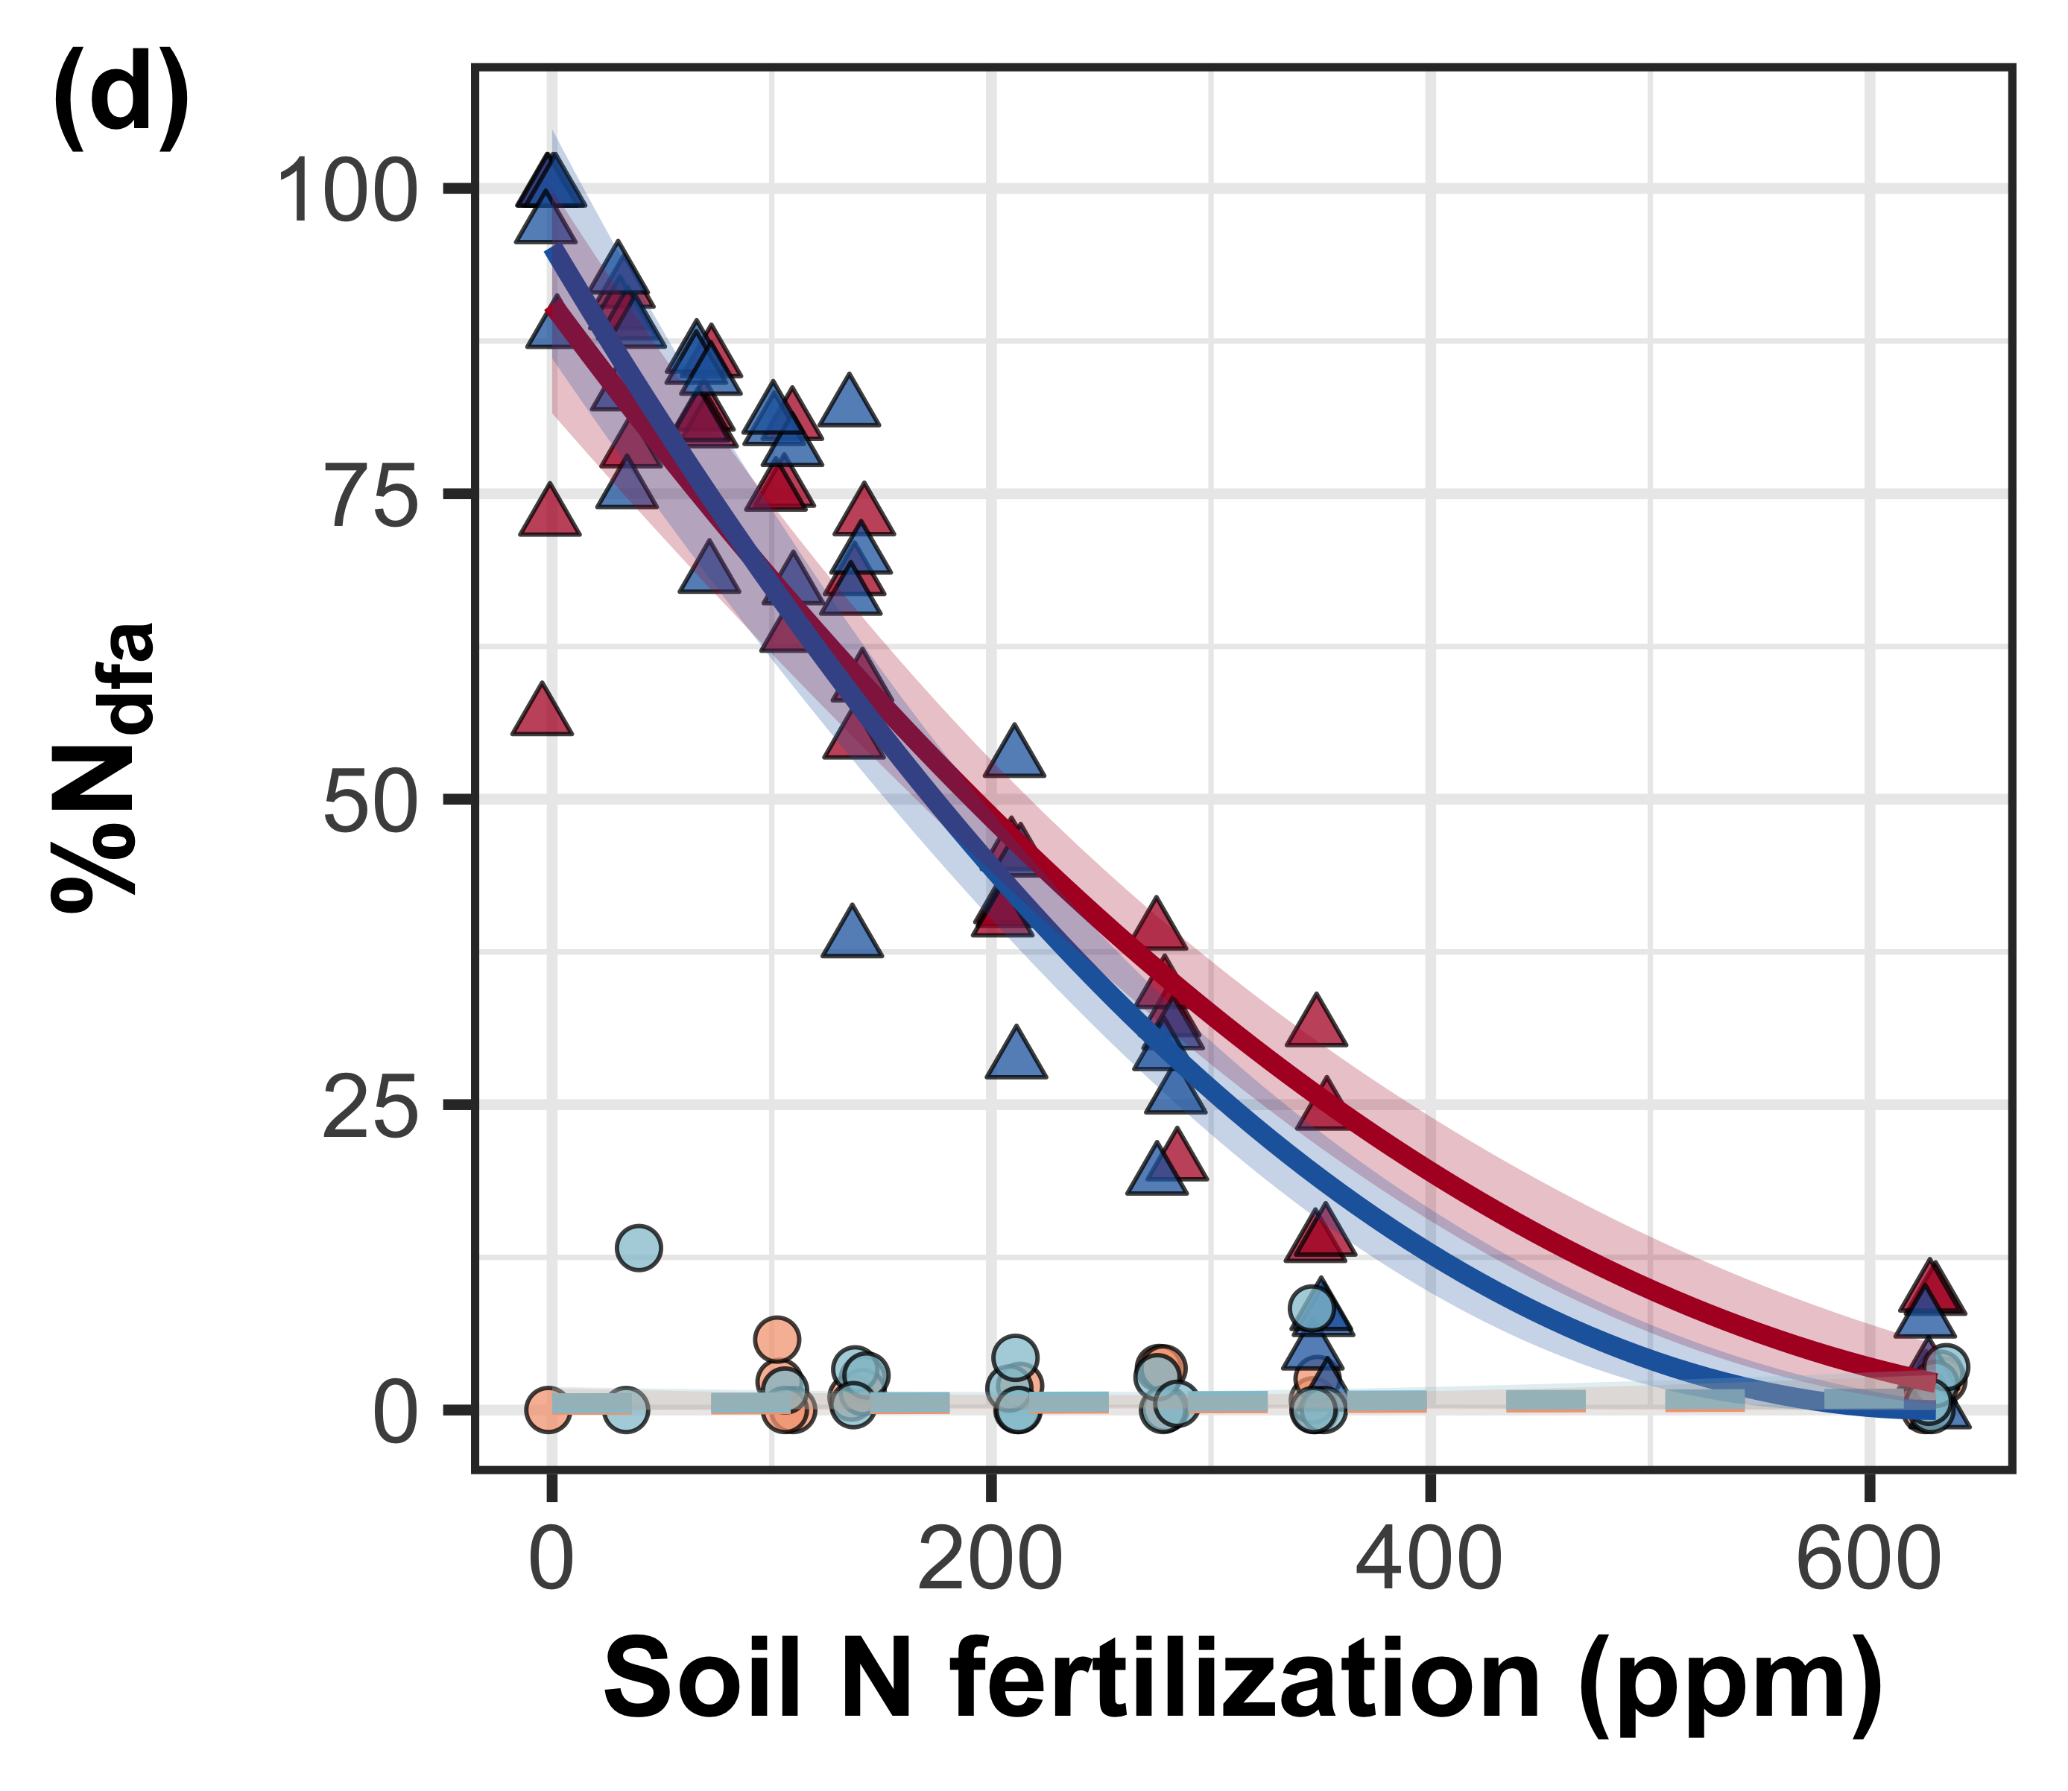
Increasing fertilization decreased the percent of leaf nitrogen content derived from the atmosphere
CO₂: | NS
Fertilization (N): | p<0.001
Inoculation (I): | p<0.001
CO₂*N interaction: | NS
CO₂*I interaction: | NS
N*I interaction: | p<0.001
Notes:
- A response that was likely driven by high investment in nitrogen fixation under low fertilization

Slide 58
Conclusions
N demand and supply control plant responses to eCO₂ at different scales
N supply → whole-plant response to eCO₂
N demand → leaf response to eCO₂
Leaf and whole plant responses to fertilization are dependent on acquisition strategy
eCO₂
Photosynthetic capacity
Soil N supply
Whole-plant growth

Slide 59
Increasing fertilization increased photosynthetic capacity, but only in uninoculated plants

Slide 60
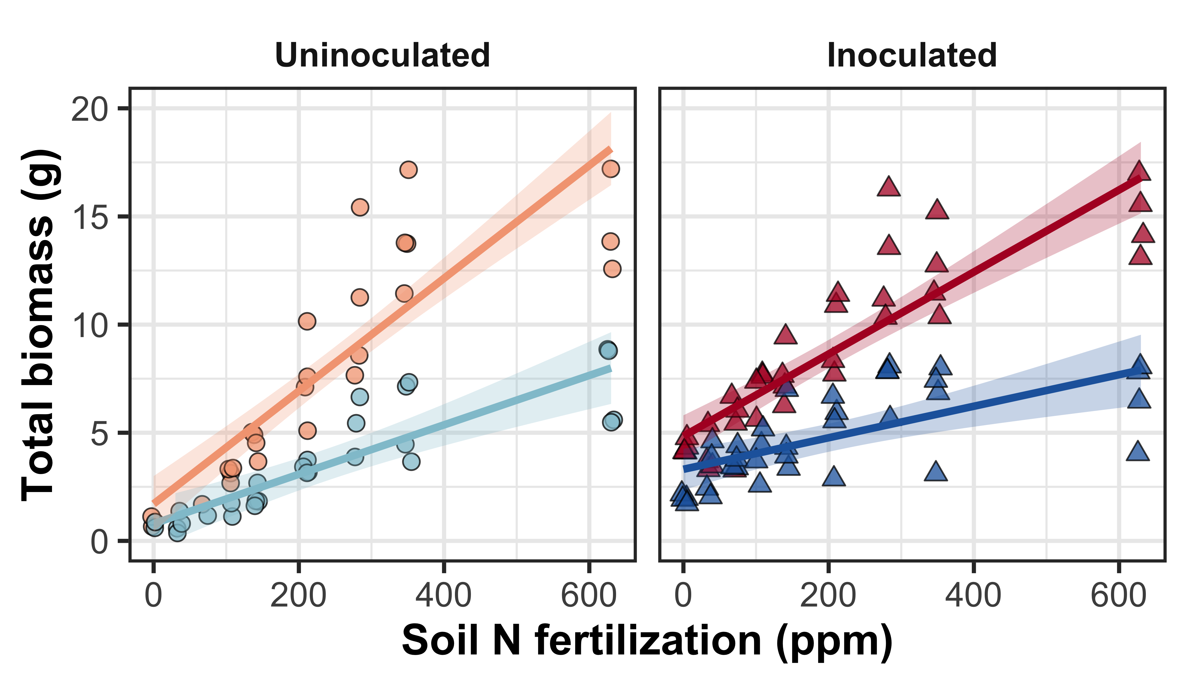
Increasing fertilization increased total biomass more strongly in uninoculated plants

Slide 61
Conclusions
N demand and supply control plant responses to eCO₂ at different scales
N supply → whole-plant response to eCO₂
N demand → leaf response to eCO₂
Plant responses to fertilization are dependent on acquisition strategy
eCO₂
Photosynthetic capacity
Soil N supply
Whole-plant growth

Slide 62
Conclusions
N demand and supply control plant responses to eCO₂ at different scales
N supply → whole-plant response to eCO₂
N demand → leaf response to eCO₂
Plant responses to fertilization are dependent on acquisition strategy
eCO₂
Photosynthetic capacity
Soil N supply
Whole-plant growth
Acquisition strategy

Slide 63
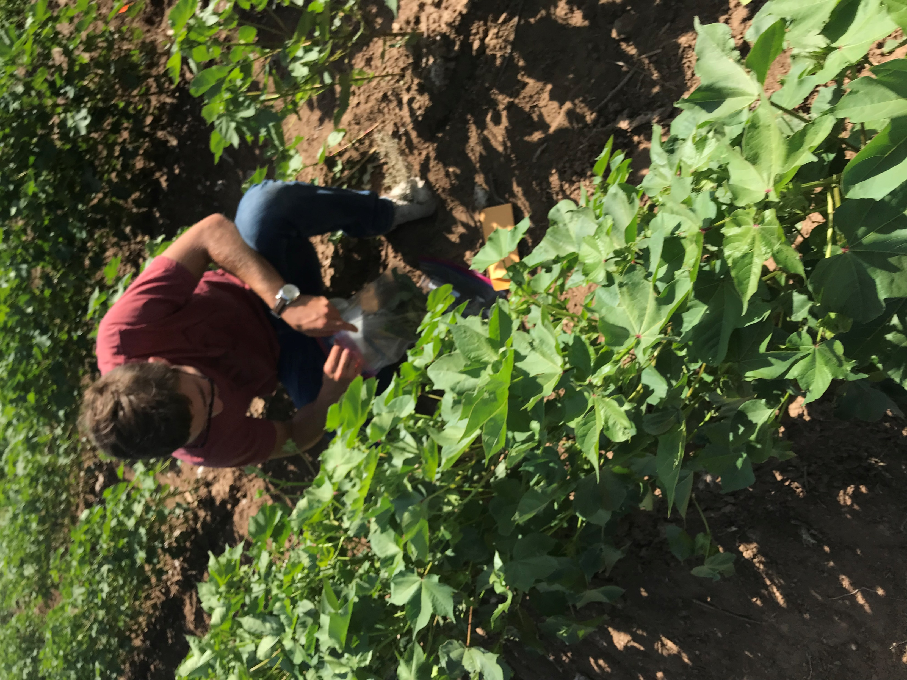
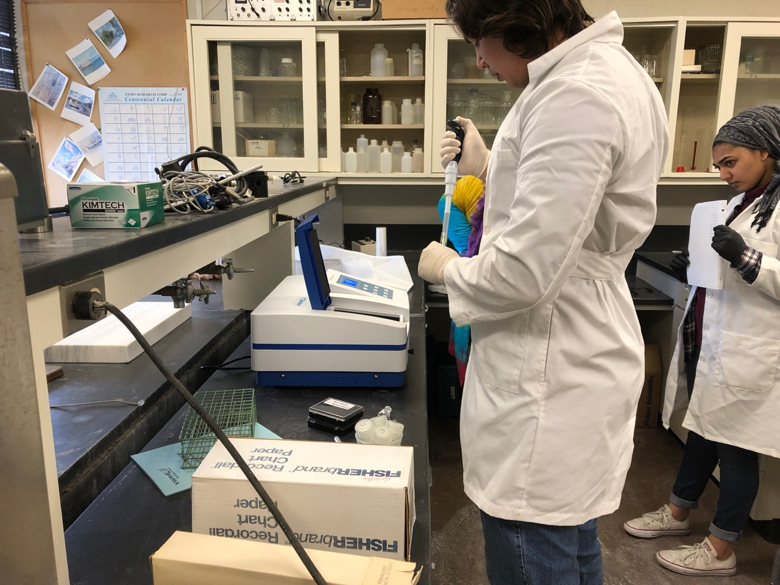
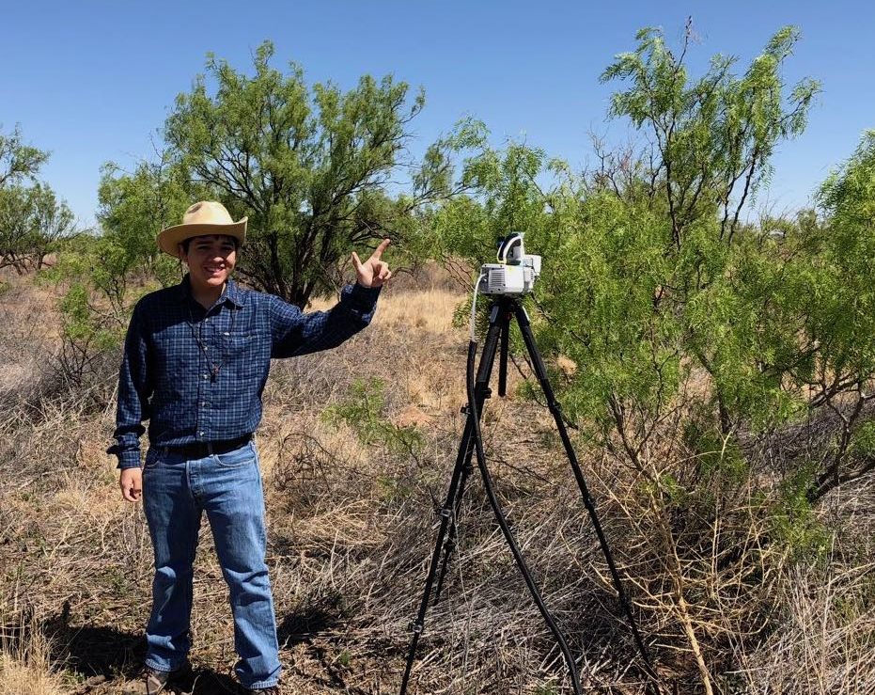

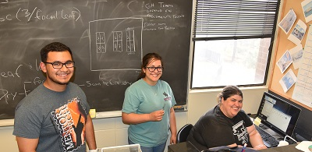
Acknowledgements
Undergraduate Researchers:
Josh Gutierrez
Jorge Ochoa
Austin Cooper
Mahum Haque
Angel Barron
Leah Ortiz
Kobe Young
Dave Baychoo
Zachary Bailey
Members of the Schwilk and van Gestel Lab
Dr. Paxton Payton (USDA)

Slide 64

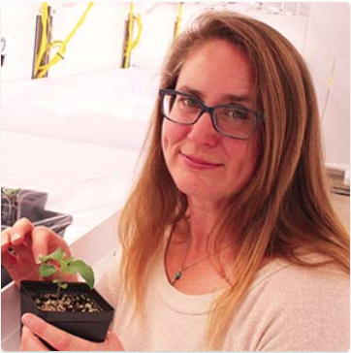




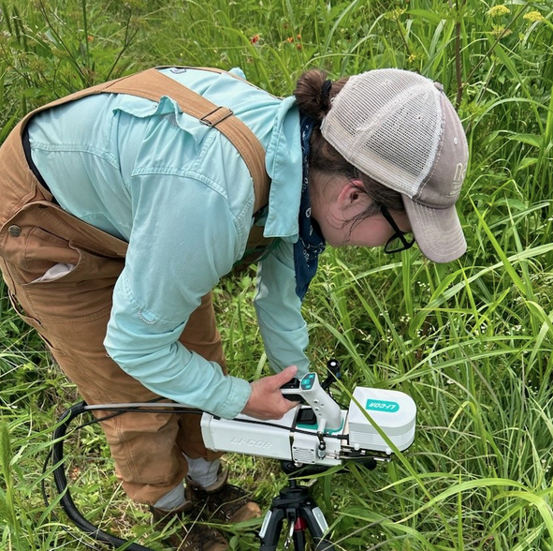
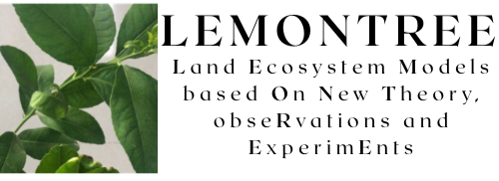





Acknowledgements
Mylea Lovell
TTU Phytotron manager
Alissar Cheaib
Smith Lab Post-doc
Brad Posch
Former Smith Lab Post-doc
Kieran Carroll
Smith Lab Manager
Lizz Waring
Former Smith Lab Post-doc extraordinaire
Monika Kelley
Smith Lab PhD student
Zinny Ezekannagha
Smith Lab PhD student
Snehanjana Chatterjee
Smith Lab PhD student
Hannah German
Former Smith Lab UG student

